Slide 1


Proposal
Data Platform Roadmap
AIAT Technology, Digital & Analytics Initiative
January 2021

Slide 2






 | Client centricity AIA is designated as one of top global priority accounts. The status is a tangible recognition of AIA’s importance and our ability to bring the right people and skills from across the globe to AIA Thailand.
 | Familiarity with AIA Data & Cloud We have collaborated in designing Cloud-based Data & Analytics Platform and Cloud Strategy under TDA initiatives for AIA Group and AIA HK. We will leverage our relevant experience and learnings from working on multiple AIA initiatives at the group and business entities around the world.
 | EY & Microsoft alliance EY has been awarded as global advisory services partner for Microsoft. This means we are able to work with Microsoft leaders, architects and top talent to validate our design & approach. We have also delivered Microsoft services at AIA around Cloud migration for data & applications and MS Dynamics.
 | EY Data Science & Data Management Platform We have worked in numerous data management platform engagements in APAC. We will bring in SMRs and utilize EY’s existing frameworks, methodologies and accelerators for data platform in our project with AIA Thailand.
 | Team of data and analytics specialist Our team consists of members with multi-disciplinary background. Not only we will engage those with strong data analytics experience, but we will also bring those with good understanding in insurance business in Thailand.
Executive Summary
EY Advantages

Slide 3
Table of Contents
Our Understanding of Your Needs
Why EY
Our Point of View & Approach
Value Added
Timeline
Our Team Structure
Our Credentials
Assumptions

Slide 4

1
1| Our Understanding of Your Needs

Slide 5
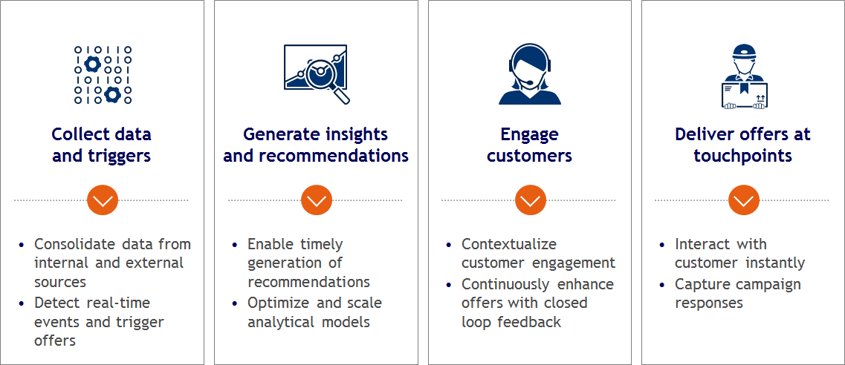


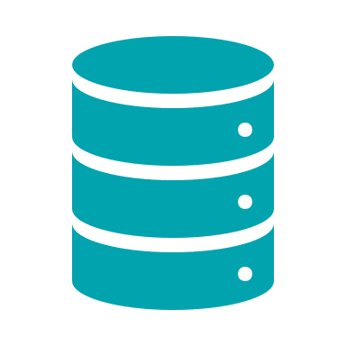




Our understanding of your needs
AIA Thailand (AIAT) is embarking on an aspirational journey to uplift capabilities in Technology, Digital and Analytics over the years. The program will require AIAT to deploy new systems, products and features into production. AIAT need to understand more the Data Platform Roadmap to be a principle while implementing the projects.
Key outcomes delivered by the program:
Your specific asks
Perform assessment study on AIAT environment on following areas:
As-is assessment of existing data platform architecture current Group IT / AIAT Roadmap Standard
Identification & prioritization of data platform related use cases leveraging the target data platform
Providing target architecture of data platform, & platform integration with related systems
Providing recommendation on Data Science Lab -VM vs the Azure ML
Estimation of cost & resources to build & maintain the data platform
Providing recommendation on Data platform high-level organization and operation model
Providing roadmap to achieve the target platform and implement use cases altogether with the dependency across TDA projects i.e. Cloud Migration Platform
Data Platform capability gaps report
Data related use cases identification & prioritization report
High Level Data Platform Architecture Design including Azure’s module & implementation cost
Data platform high-level organization and operation model
Strategic IT Roadmap for Data platform area

Slide 6
2
2 | Why EY

Slide 7
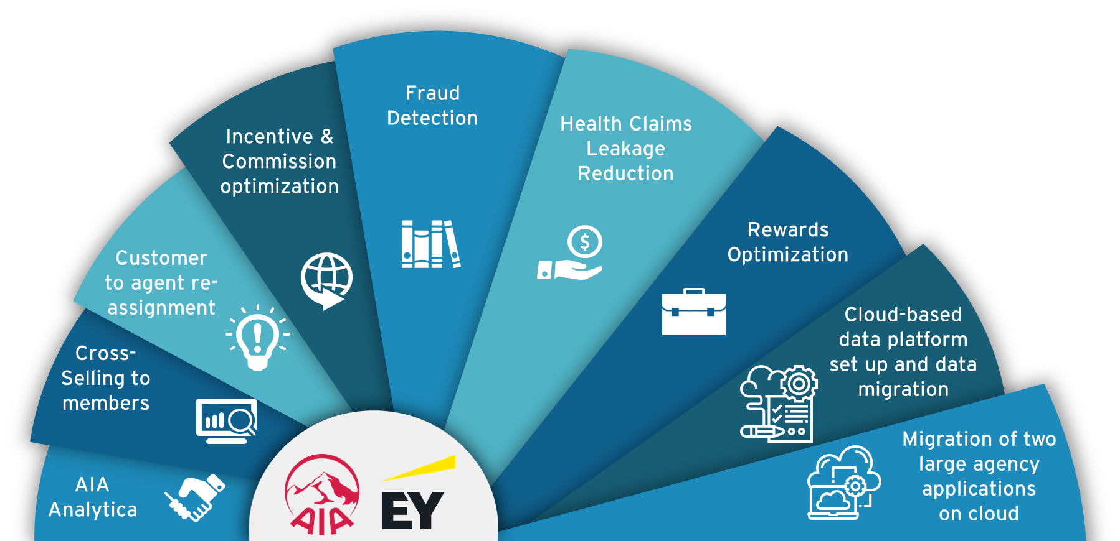
With our diverse existing engagements with the Group, we believe that we are capable of delivering and accelerating the outcome from the current asks
We have worked with AIAT and AIA Group on deploying a variety of data analytic use cases in multiple AIA business units and it is our ambition to support AIAT in this journey to uplift capabilities in Technology, Digital and Analytics over the next 3-4 years.

Slide 8


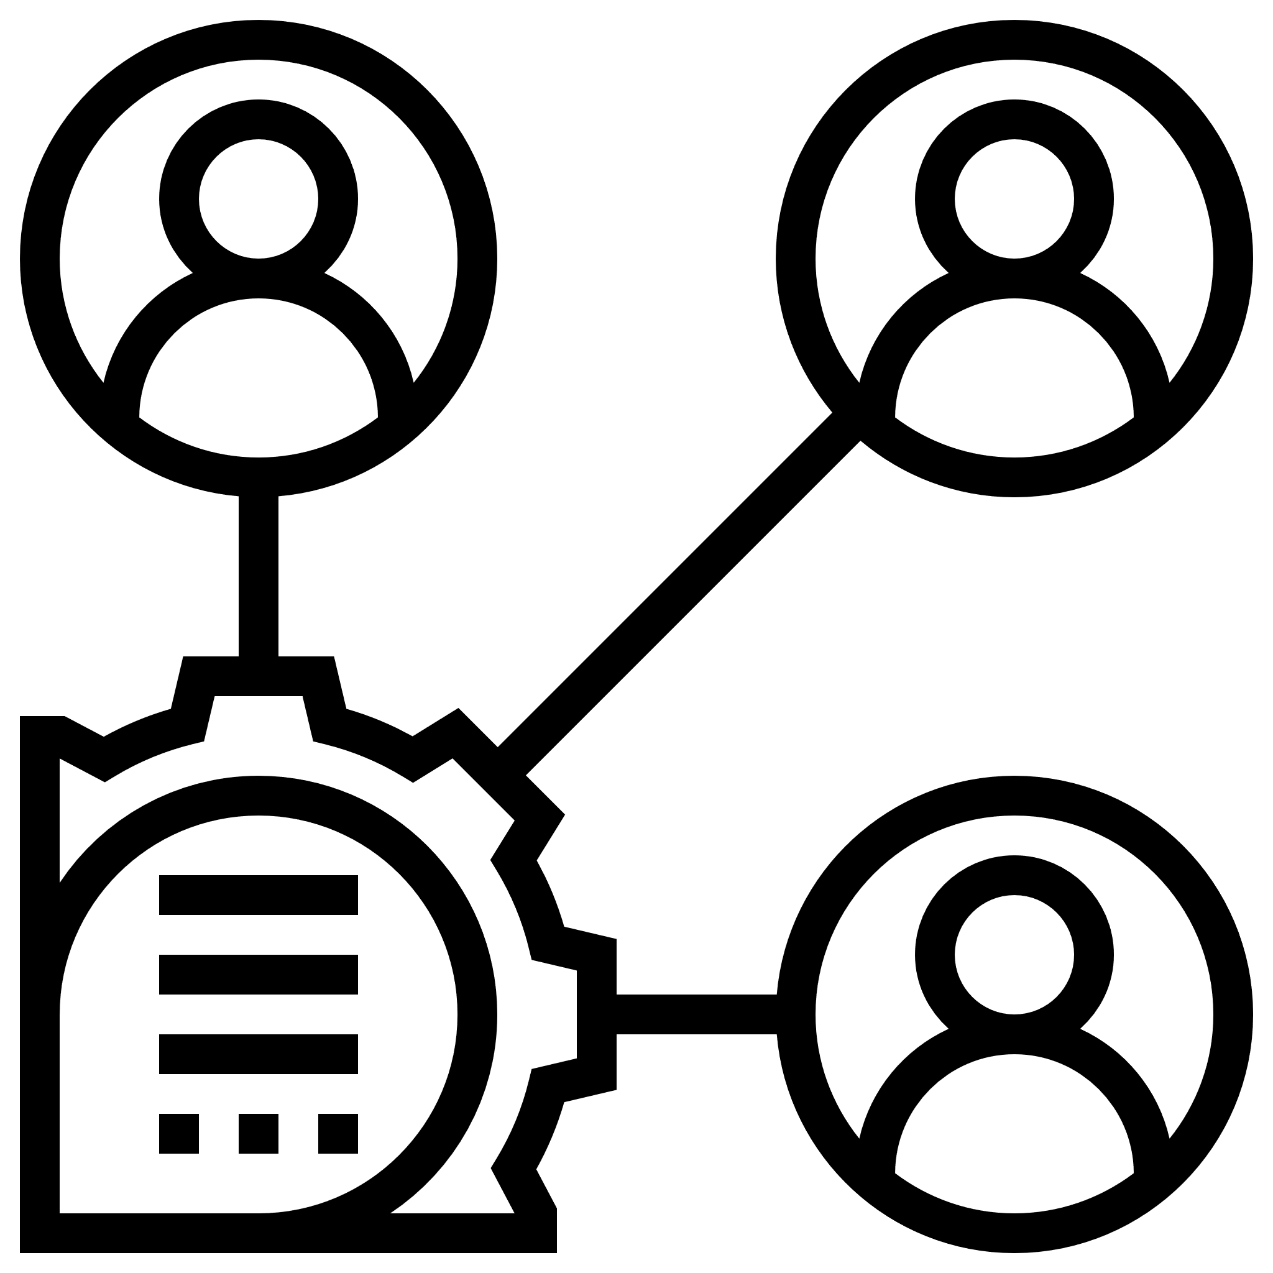



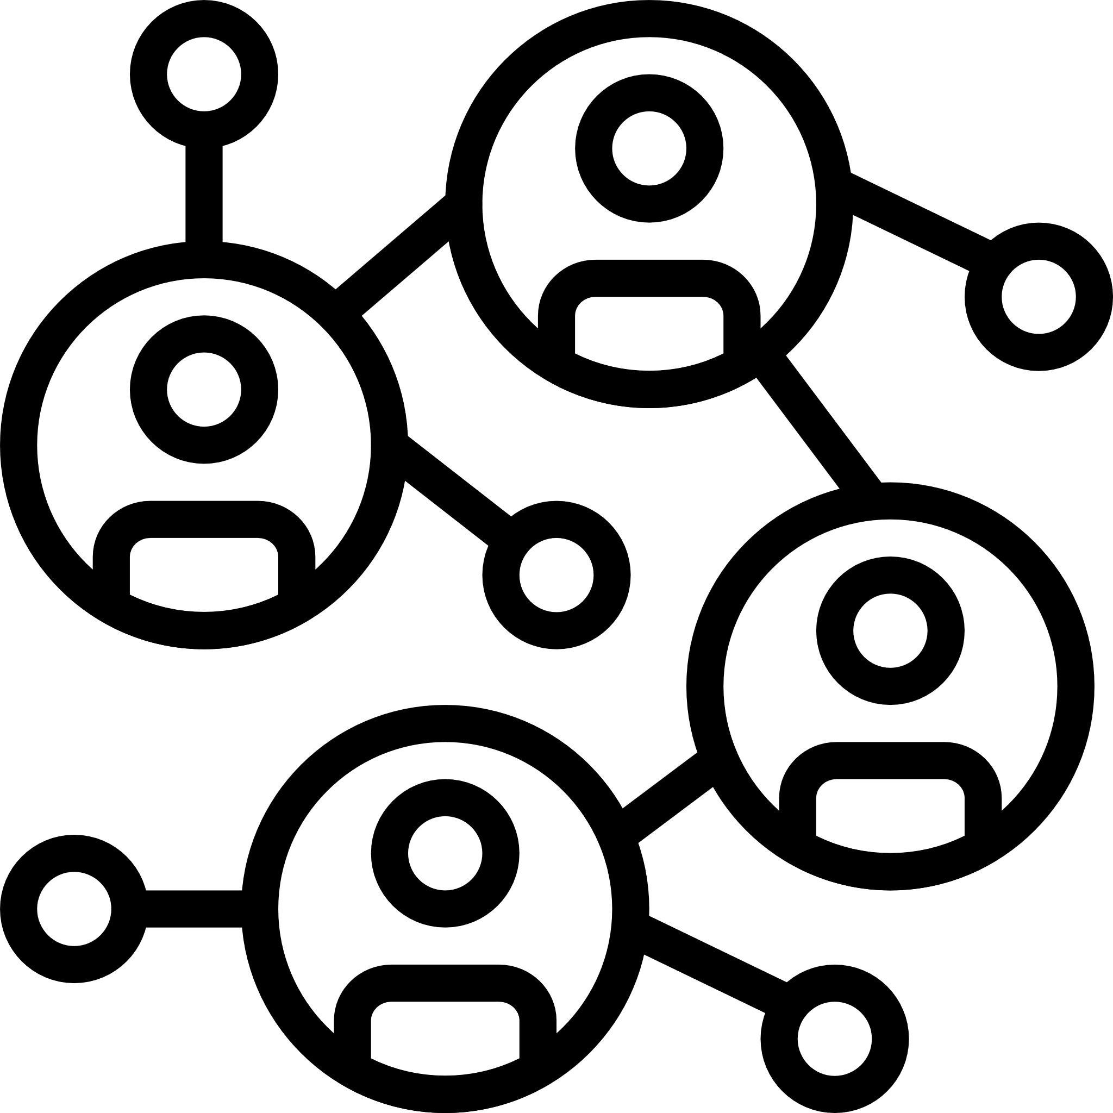


We will leverage our key learnings from our previous engagement with AIA HK to optimize the time and resources required for our project
1. Engage Business Stakeholders early on the journey
2. Engage Design Authority Stakeholders early
3. Only use approved AIA Group Approved Azure Services
4. Limit UAT Cycles
5. Define Business Benefit for Each Use Case
6. Engage Change Activity Board early
7. Automation
8. Limit UAT Cycles
9. Perform Multiple Small releases into Production
1. | In order to ensure that the proposed Data Platform meets requirements, we strongly advise AIATH to engage business stakeholders to understand and document their proposed use cases for the Data Platform. By ensuring business support and early engagement, the proposed architecture can be designed to meet current and future requirements.
2. | Design Authority approval requires endorsement from several different stakeholders within Business & I.T such as Enterprise Architecture, Networking, Infrastructure, Tech Risk, Compliance and occasionally finance. We recommending socializing the proposed Architecture with each stakeholder group in separate meetings prior to seeking final endorsement at the Design Authority Committee.
3. | AIA Group have a catalog of approved Azure Services with recommended security control that should be applied when used within an architecture. We recommend only using these services as it takes 6-8 weeks to get a new Azure approved for use by AIA Group.
4. | Ensure that the assessment considers the AIA Group standards and architecture patterns, including the current TDA roadmap for Thailand and Group. Consultation with Group architecture once the design is mature will avoid potential implementation complexities.
5. | For each proposed Analytics Use Case, define the quantifiable benefit (increase in VONB, decrease in cost etc..) and assign a business owner to each use case.
6. | Understand what the requirements are for the Change Activity board in advance of scheduling a Production release. Change Activity Board (CAB) requires several documents to be endorsed prior to scheduling a release e.g. Design Authority, Tech Risk/Compliance, Operations Guide
7. | When building the platform, build it using infrastructure as code. This will expedite the environment build process for each subsequent environment in TEST, SIT, UAT and PRE-PROD environments.
8. | Limit the UAT testing cycles to a maximum of 2 with well documented test cases that address all of the proposed functionality within the platform. By limiting UAT to only 2 cycles, it reduces the impact on business users and avoids testing fatigue.
9. | By executing a series of mini-releases into production, you mitigate the risk of infrastructure/networking problems occurring. Each environment may have different networking configurations which could cause potential issues. We recommend performing small releases to iron out any potential issues.
Key learning from AIA HK
*EY has built a repository of Data Platforms that have been scripted as infrastructure as code and can be easily tailored for AIATH environment.

Slide 9
We understand AIA Ascend 200’s data analytics use cases and we will bring in the knowledge and skills required for the deployment of the use cases selected by AIAT
AIA Ascend 200’s data analytics use cases
++ Data & Analytics Platform
EY’s legend:
Use case has been deployed in multiple AIA BUs
Use case deployed at one AIA BU, deployed at peers
EY strength from other clients, not applied at AIA

Slide 10

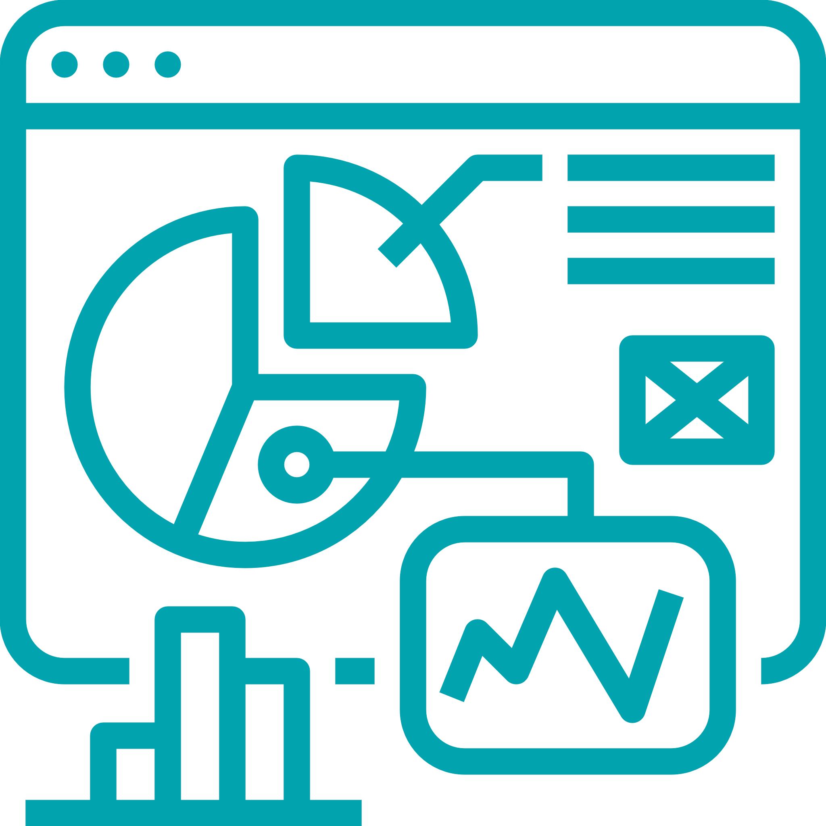
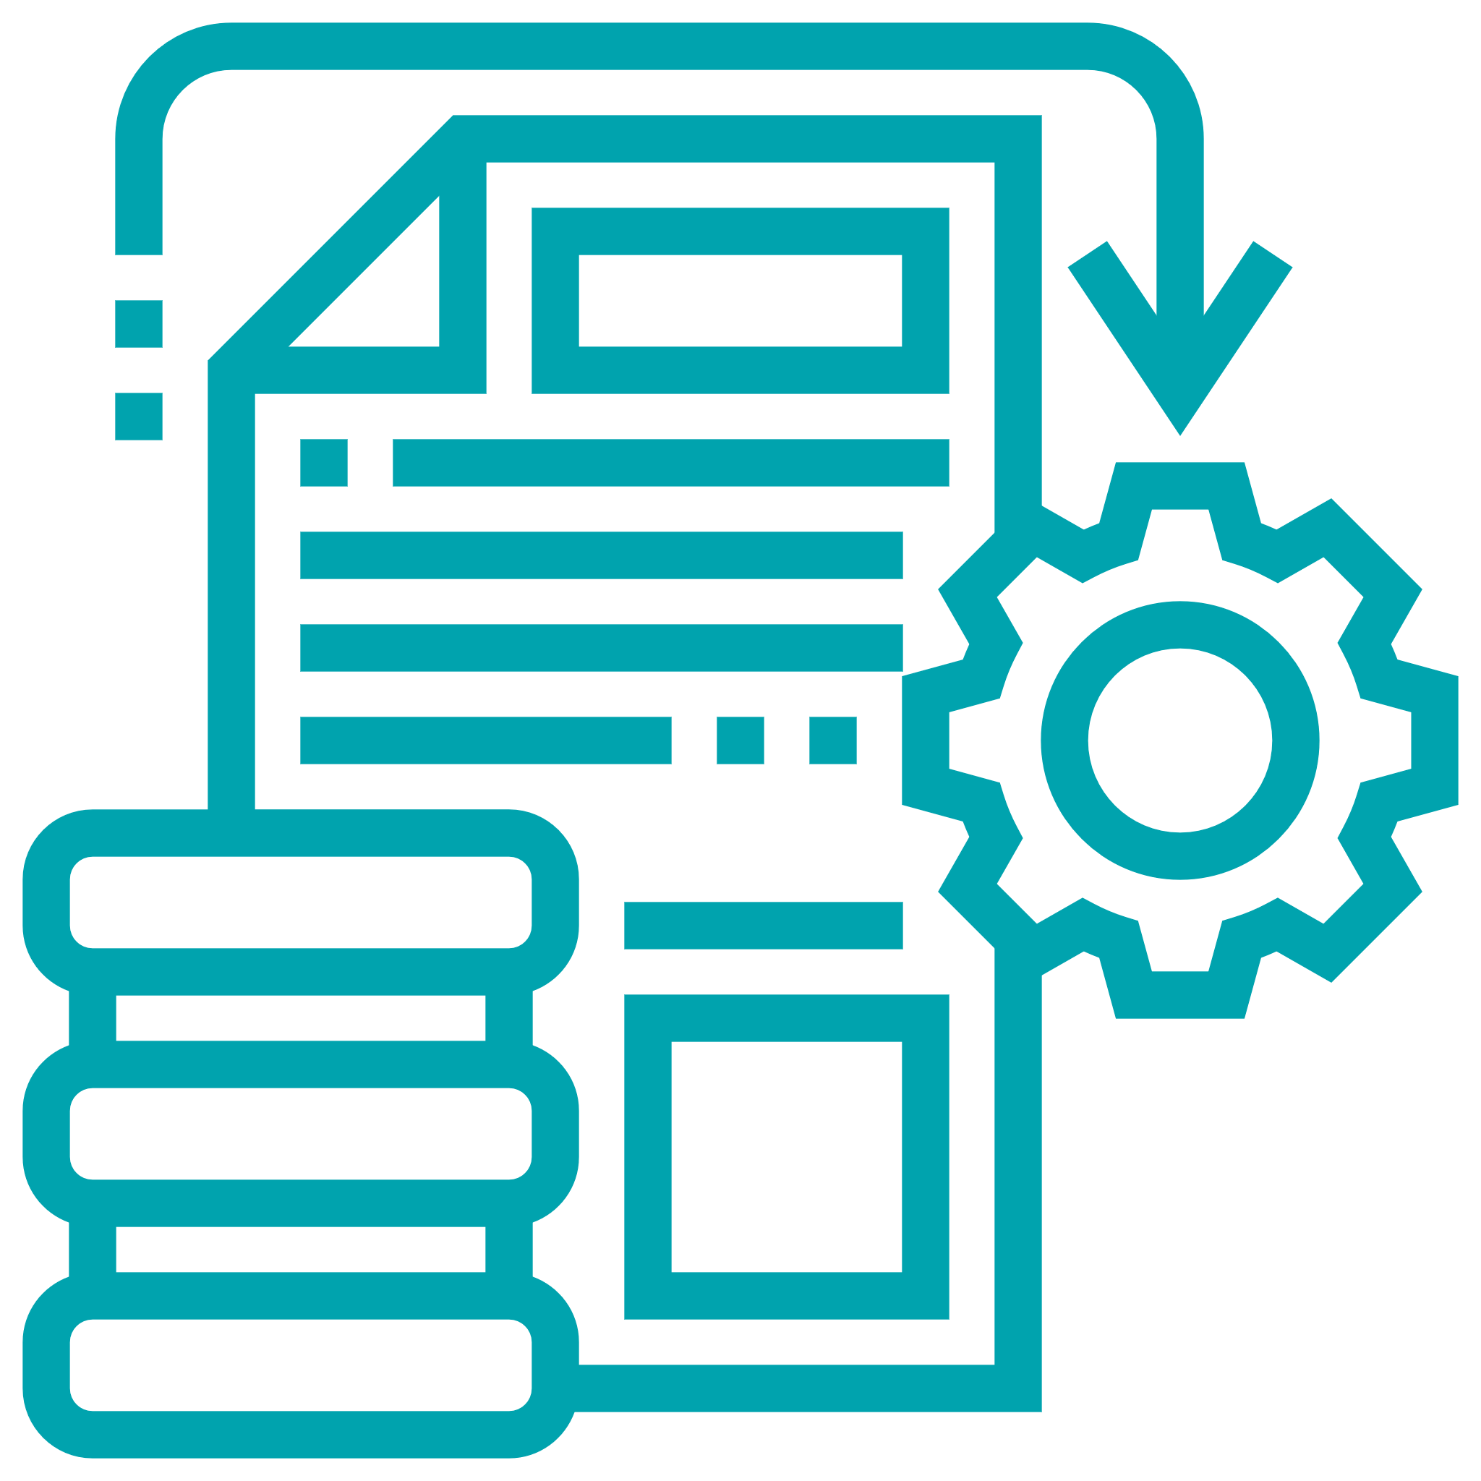
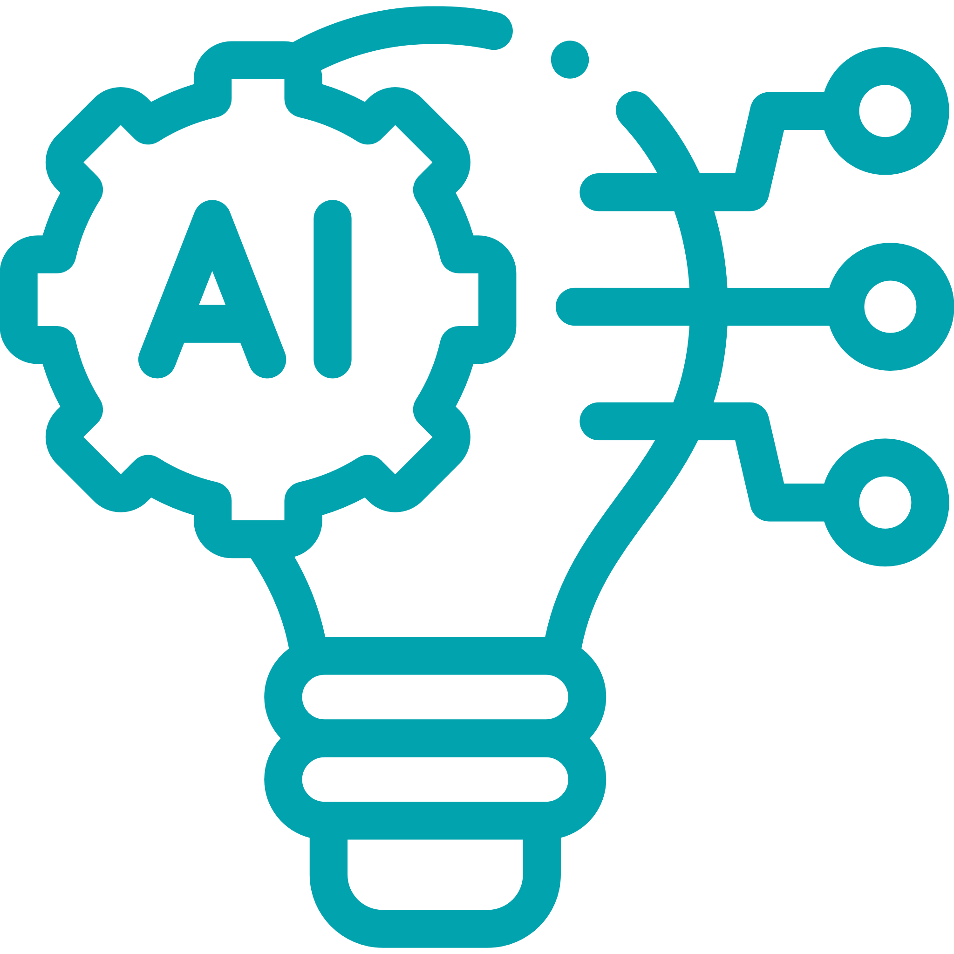
We have a team of expertise for our four core Data & Analytics capabilities, who will be supporting AIAT’s technology, digital and analytics journey
Data Governance | BI/Analytics | Information Management | AI/Machine Learning
EY helps our clients better manage enterprise data and feel confident in its accuracy and reliability by executing data governance policies and standards. | EY helps our clients realize the full potential of their data through effective reporting and analysis and key metrics. Furthermore, EY helps our clients with a comprehensive set of capabilities to analyze and review business data for key indicators. | EY helps our clients develop strategic information plans and blueprints for collecting, storing, maintaining, recalling and using data through the full data lifecycle. | EY helps our clients unlock hidden value within structured / unstructured data and deliver transformative business outcomes through the combination of AI technologies such as machine learning, computer vision, natural language processing with data science and analytics.
Our services include: Data governance current state assessment, target state vision and initiatives roadmap Build policies, processes and procedures for sustainability Data governance organization model, KPIs & dashboards Data accessibility, availability, integrity and consistency Data quality control | Our services include: BI/Analytics blueprint Visualization & reporting using BI tools Mobile management dashboards using agile methodology Banking analytics across marketing, collections, operations, fraud, AML upgrade or migration Out of box insurance analytics like persistency, early claims, fraud claim, price optimization and underwriting | Our services include: Data strategy, architecture and roadmap Data warehouse implementation Data warehouse remediation Big data use case development & implementation Data Migration for BCM & WAM Metadata management Master data management Data Integration including ETL, ELT service | Our services include: Marketing Analytics & Campaign Management Predictive Modelling Hyper-personalized Real-time Targeting Customer Engagement & Revenue Optimization Intelligent Automation Document Digitization Compliance Monitoring Natural Language Understanding Systems
Marketing | Distribution | Operations | Finance | Asset Management | Risk | HR | Technology | Other

Slide 11














Our Data & Analytics team has a large presence in APAC market and we can work as one co-located team to support AIA Thailand
Number of FTEs for our EY global technology team
User Experience
Data & Analytics
Digital Technologies*
*Digital tech includes PM, BA, SA

Slide 12

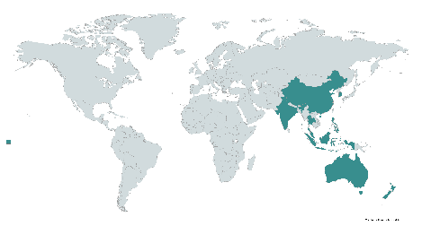






The EY and Microsoft alliance combines deep EY insights and experience in disruptive industry trends, new business models and evolving processes with scalable, enterprise cloud platform and digital technologies from Microsoft
EY Team (Asia Pacific)
1000+ Microsoft Advisory Professionals
25 offices present across Asia Pacific
EY’s strong connectivity enables us to assemble the right teams, share leading practices across the world and address your cloud needs
Global Advisory Services Partner of the year, 2020
Global Financial Services Partner of the year, 2020
Global Energy Partner of the year, 2020
Our Microsoft Practice
EY & Microsoft Competencies
We are a Microsoft Gold partner and our professionals have demonstrated successful implementations, capabilities and technical certifications to meet the rigorous requirements to attain these competencies
Gold Application Development Gold Cloud Business Applications Gold Cloud Customer Relationship Management Gold Cloud Platform Gold Cloud Productivity Gold Collaboration and Content Gold Data Analytics | Gold Data Platform Gold Datacenter Gold Enterprise Resource Planning Gold Messaging Gold Project and Portfolio Management Gold Security
Our digital solutions, powered by Microsoft technologies, help clients unify data and workflows to boost innovation, empower their people, engage their customers and optimize their operations. These innovative solutions digitalize enterprise strategy, transform customer and workforce experiences, create data-driven business processes, build intelligent, automated operations and are secure, compliant and trusted.
Built the Cloud Strategy & Cloud Centre of Excellence for AIA Group
Performed the end to end Enterprise Data Warehouse Migration for AIA HK
Assisted a leading Australian bank to help cut infrastructure provisioning time from 20 days to hours and managed services costs by millions of dollars
Built and Azure based innovation platform to host an end-to-end AI/ML capability; processing real-time and batch data to generate personalized actions and content
We make it our business to understand your business and to keep our advice relevant to your needs
We believe in taking an iterative & incremental approach
We are built to deliver with the best user experience
We are abreast of latest innovations in the market
We understand Cloud

Slide 13
3
3 | Our Point of View & Approach
Data Platform Capability
Use Case Identification & Prioritization
Data Platform Architecture
Target Operating Model
IT Strategic Roadmap

Slide 14
3.1
3.1 | Our Point of View & Approach
Data Platform Capability
Data Platform Capability
Use Case Identification & Prioritization
Data Platform Architecture
Target Operating Model
IT Strategic Roadmap

Slide 15
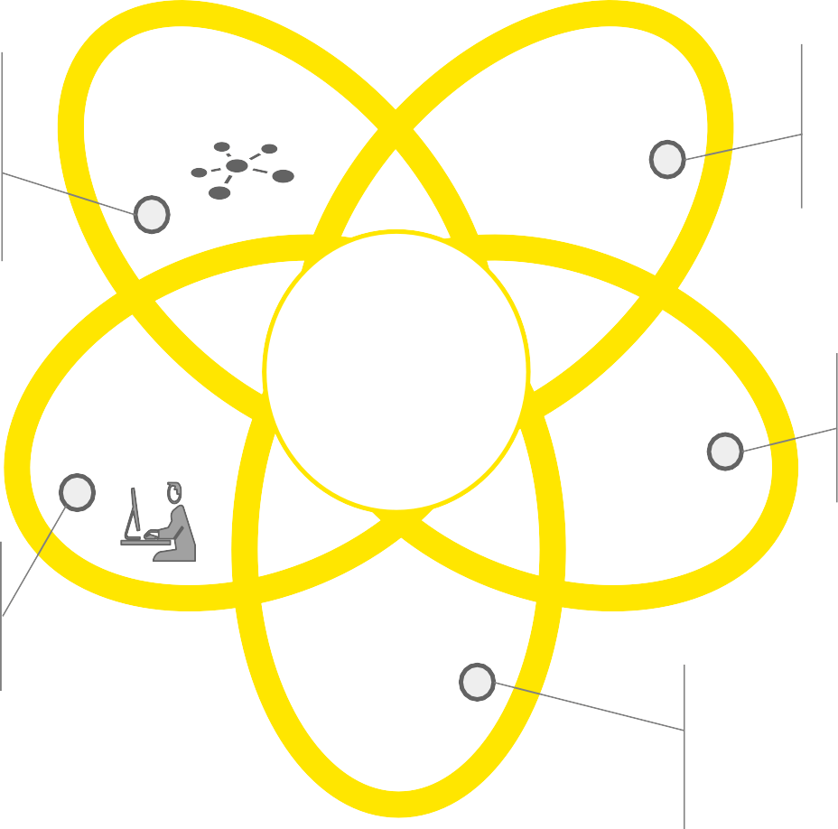



There has been a global shift towards adoption of Next-Gen Data Platforms for enterprises to enhance their Data-related capabilities
Point of View
Next Gen Data is a new Data Management approach that leverages advancements in technology, storage, cloud, and Machine Learning capabilities to
process more quantity and types of data, empowering more users with self-service, and yet maintaining transparency and auditability of data.
► Data lake based architecture is robust and scalable; ensures full fidelity of source data in an immutable zone, and can be deployed on hybrid cloud/on-prem infrastructure
► Supports multi speed data processing, Microservices, and advanced data security
Data Lake Based Platform
AI / Machine Learning Based Data Management
► AI enabled real time Data Management, in line data quality, dynamic data mapping, tagging, indexing, data cataloging, and provisioning
► Support for Curated data sets and enhanced audit trails and lineage
Next Gen Data
► Provides support for structured and semi-structured, and unstructured data (such as, signal, social media, voice / speech, text, web logs, encrypted packets, etc.)
Enterprise-wide Data Delivery
Diverse Data
► Data made available to the enterprise through self-service analytics and reporting, advanced visualization capabilities, virtualization, and context based data delivery
High Speed Computation Engines
► Connected streams (pushing data in real time and ensuring latest data being consumed in the event of change in state of data); centralized business rules ensures data transformations are applied on the data in real time

Slide 16
Legacy Architecture v/s Next Gen Architecture
Point of View
While firms have desired an integrated risk and finance architecture for many years, legacy technology constraints have made this challenging to achieve. Advances in new technologies like low cost cloud based infrastructure and machine learning have made such an architecture possible.
Legacy Architecture
Traditional warehouse based architecture with numerous hops, rigid data model, and manual processes
Next Gen Architecture
Data lake based architecture with unified sourcing and consumption, flexible and iterative data model, supported by automation
Implementation duration of ~24+ months with
expensive and lengthy future changes
Reduced cost due to rapid development with quick
iterations having duration of weeks to months
Data management is “offline” with many manual components
Improved insights as data is processed (inline) with
continuous learning and improvement
Does not support semi and unstructured data increasingly relevant for data enrichment and analytics
Support for all data types with potential to unlock data not yet utilized (e.g., loan origination processes, call log transcripts, etc.)
Vertical scalability to enhance data processing capability has become cost prohibitive
Ability to scale horizontally, relatively cheaply and without any limit, and on demand
Primarily suited for batch-oriented use cases (i.e., reg. and management reporting)
Supports multi-speed batch-oriented and real-time use cases (e.g., fraud detection)

Slide 17















The Next Generation Data value proposition rises as one climbs up the pyramid to adopt data-driven decisioning & insight generation
Point of View
Initial investments in infrastructure and foundational capabilities are more than offset through deceleration in spends. Real value is unlocked by progressing from the bottom of the pyramid to the top where analytical capabilities are enabled to generate real insights.
Value Proposition
Value is unlocked from the investments by developing analytical capabilities that derive insights to drive action
Enabling Capabilities
Discovery & Insights: Revenue Growth, Enhanced Client Experiences, Product & Channel Evolution
Machine learning, Cognitive Analytics, Advanced
Modeling Simulations
VALUE
Executive Insights
Reports & Dashboards
Information consumption
Analytics
Platform
Cost savings are realized from arresting the growth of legacy systems
Business Intelligence: Reporting, historical trend analysis & forecasting
Ad-hoc queries, Dashboards and Scorecards
Data Storage
Data Integration
Data Provisioning
Data Usage
Data
Security ,
Quality, Risk
INVESTMENT
Investment in the Next Gen Data platform establishes the foundation
Infrastructure & Foundational Capabilities: Scalable & Secure Platforms, Managing Data as a Corporate Asset
Robust Data Management & Governance, “Fit for Use” Data Ecosystem
Data Management &
Governance
Data Creation
Data Retirement

Slide 18

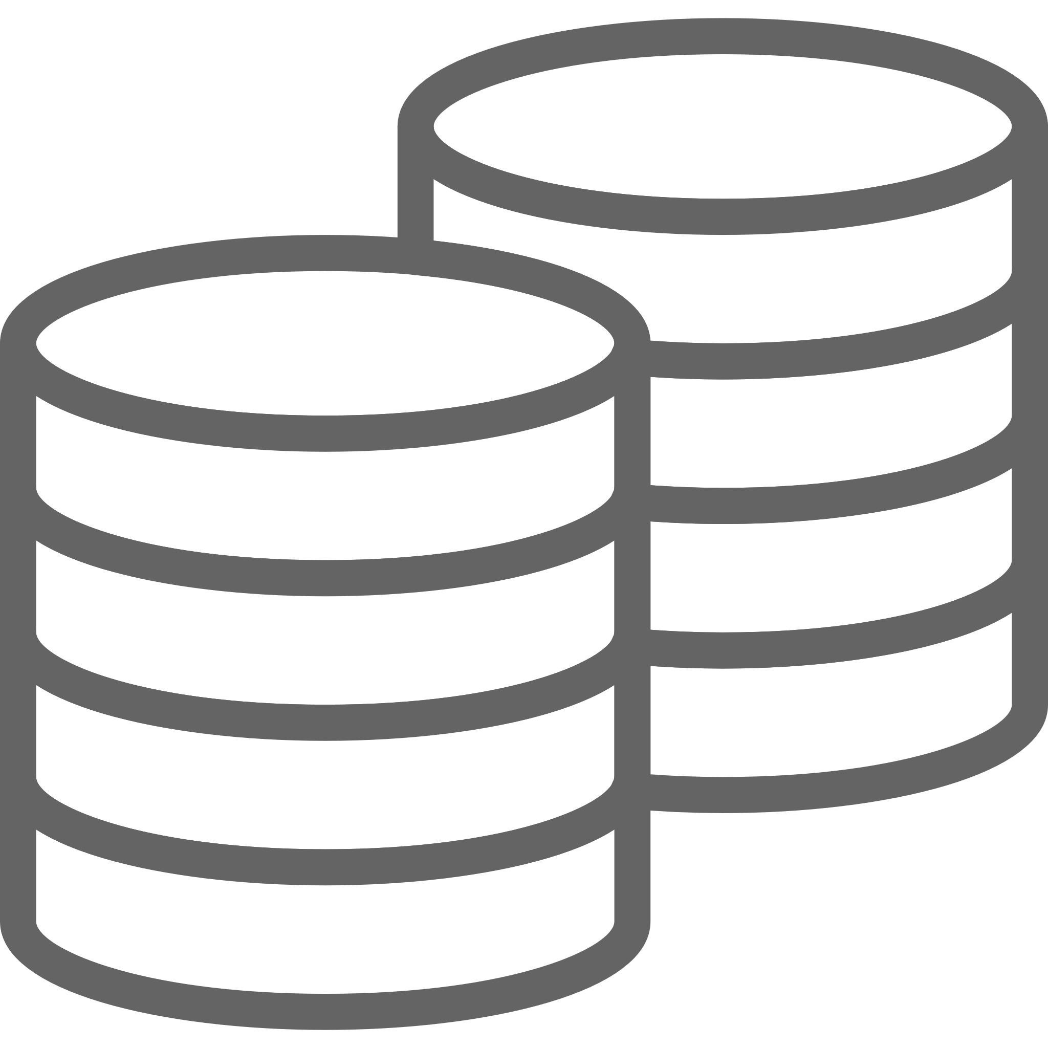


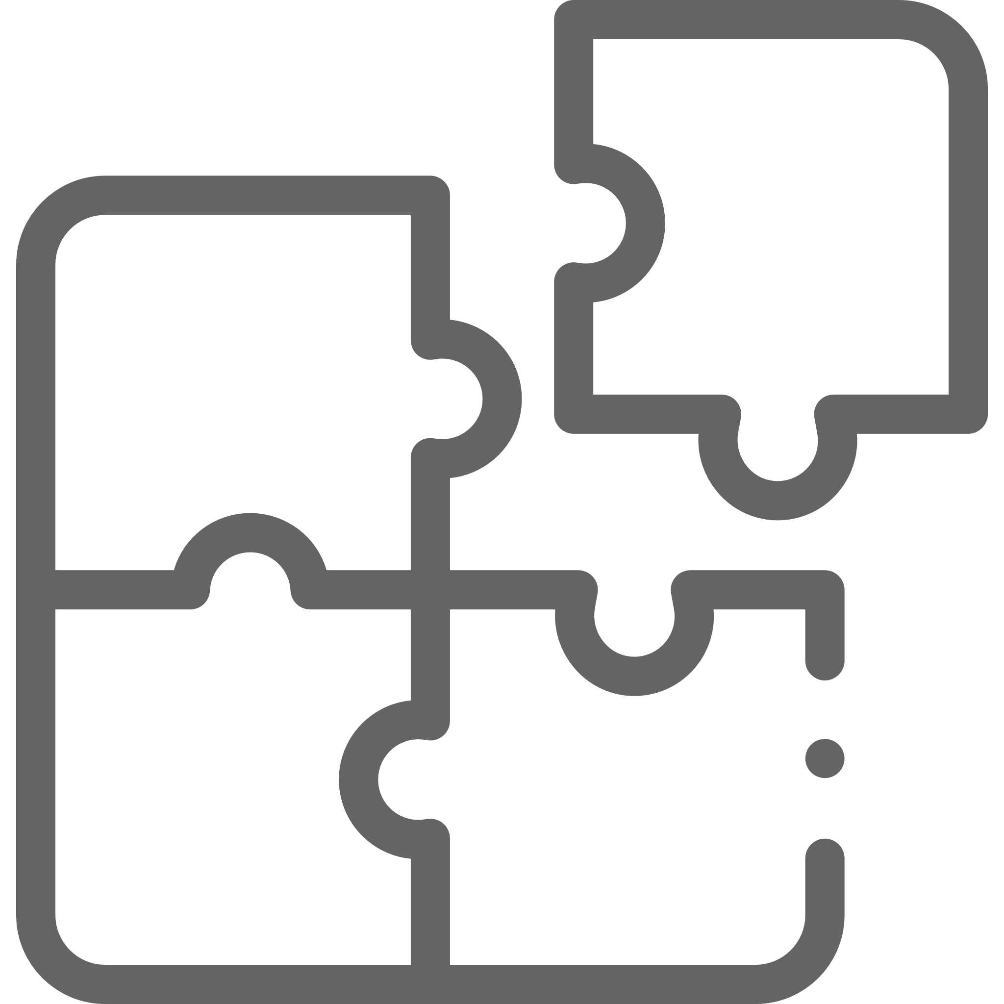
Our guiding principles for common, scalable, secured and consistent Data Platform would enable a plethora of advanced data capabilities
Guiding Principles
Common Data Layer
Consistency
AI & Analytics Ready
Secured and Governed
Forward Compatible
Supports batch and near real-time ingest frequency. Contains all master, reference, transactions, events and external data. Multilayer data stores designed to support real time and batch use cases.
A consistent view and data definition for the curated data in the customer data store. Use the same column name for common data regardless of the application name or business function.
Continuously merge, update and create analytics ready data structure, With this the data scientist would spend more time on analysis and building models rather than data preparation.
Secure data transmission and scalable data protection.
Data governance enabled with metadata automation and data quality rules.
Forward compatibility characteristic enables our proposed system to accept input intended for a later version of itself.
The proposed solution will be crafted to ensure that the infrastructure services can later be orchestrated and automated quickly to meet business demands.

Slide 19
We will bring our Next Generation Data Platform Architecture & Framework to accelerate the assessment of your current Group IT / AIAT Roadmap Standard
Framework
Data
Source
Enterprise Data Architecture
Access /
Delivery
Data Management
Claims
Governance
Standards
Data
Security
Metadata
Management
Data Quality
Audit and Balance
Control Framework
Common Exception
Handling
GDPR & Privacy
Collaboration
Policy
Billing
Streaming
Data Distribution and Provisioning
Analytic & Operational Applications
Supports data transfer and processing at a steady, high-speed rate
CRM
Data Ingestion
Data Transformation and Storage
Data Lake
Semantic Layer
Standard Reporting
Visualisation
Analytics Farm
Machine Learning
Data Discovery & Exploration
Artificial Intelligence
Enterprise Search
Virtualization
Data as a Service
Ad hoc analysis
Web Services / Portals
Complaints
Data Acquisition
Data Ingestion
Self Service
Raw Layer
Harmonized
Layer
Conformed
Layer
Provisioning
Layer
Data Repository
Rules Engine
Finance
Data
Warehouse
Data Marts
Agency
Decisioning
Semantic Layer
Mobile
Documents
Data Tagging | Indexing
Cataloging | Integration | Transformation | Curation | Preparation
Appliances
Decision Repository
Voice
Images
Shared Operational Data
Master Data
Reference Data
Operational Control Metrics
Integrated Rules
Metadata
Learning Patterns
Applications
Data Transfer
API Gateway
Synchronous Services
Asynchronous Pub/Sub Services
Event Streaming
Batch Control Management
Common Exception Handling
Key
Data
Data Store
Processing Engine
Function
Machine Learning Capable

Slide 20
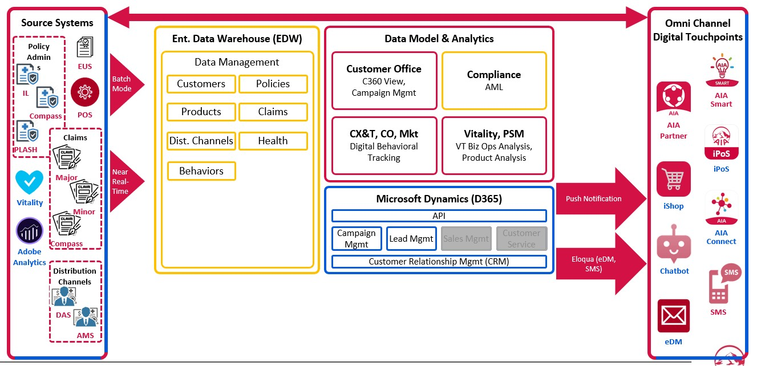
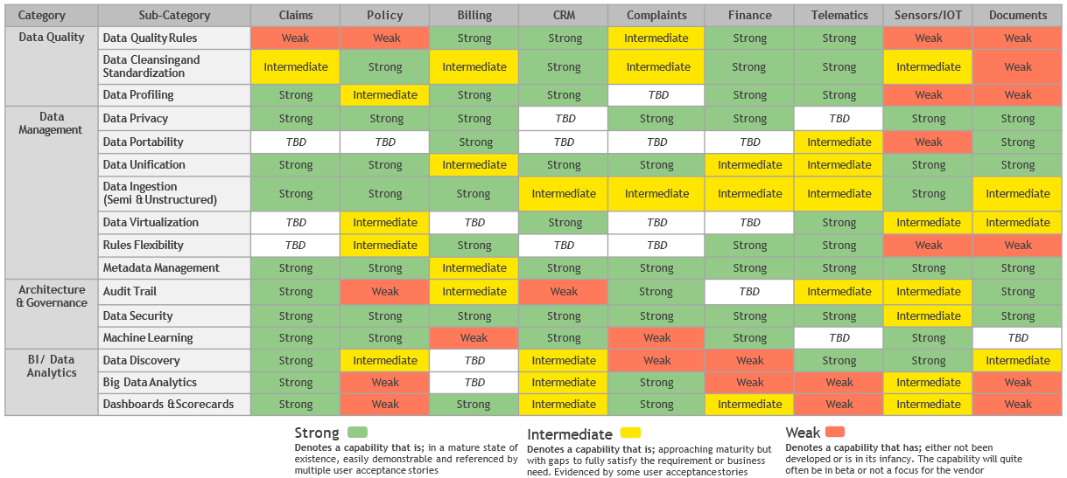
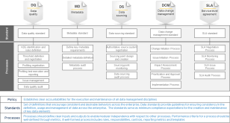
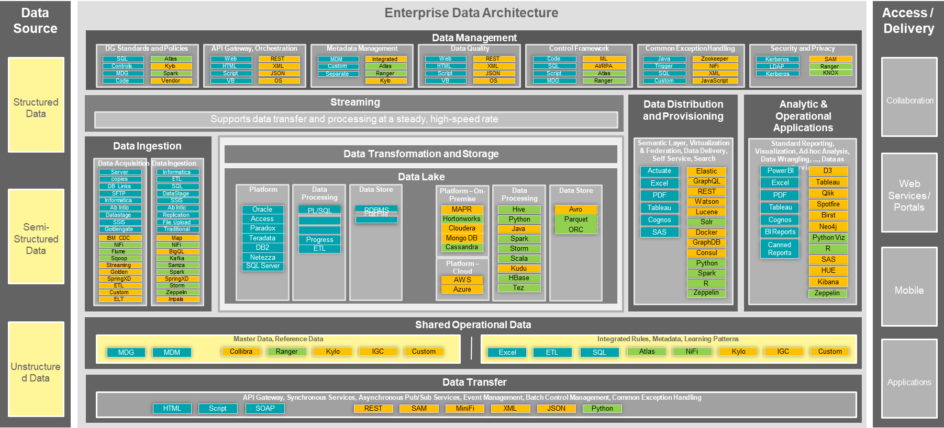
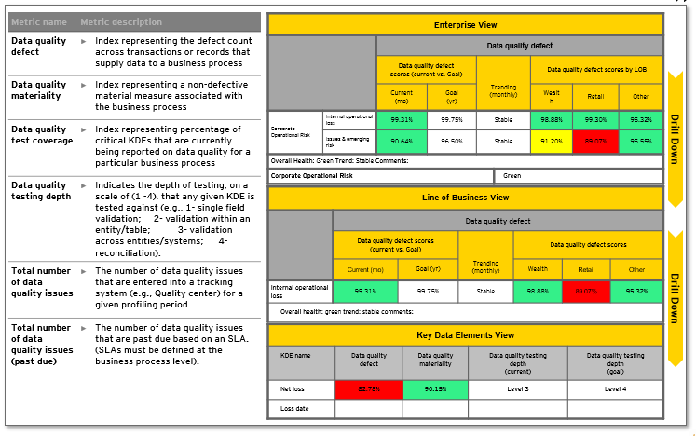
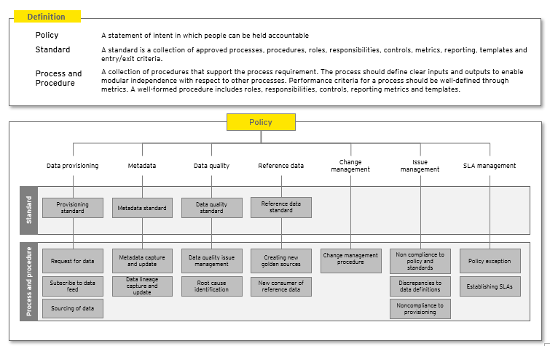
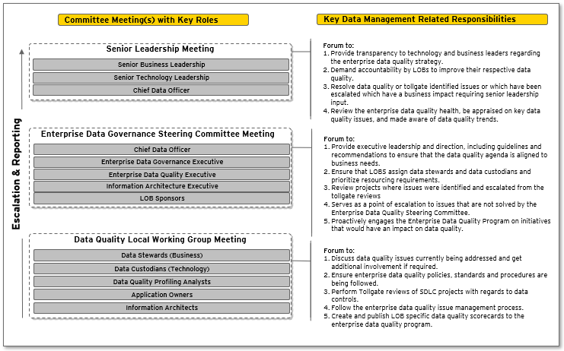
We will assess AIAT’s current Data Platform capabilities & standards across different domains against our framework to come up with a Gap Analysis
Approach
Inputs
Process
Outputs
ILLUSTRATIVE
Work Product: Data Platform Capability Gap Report
Step 1: Identify functional & business teams for the project and schedule workshops with the relevant teams
ILLUSTRATIVE
Step 2: Organize and run workshops with functional teams to understand the current state of the data platform
AIAT’s current Data Platform Capabilities
Step 3: Assess the current Data Platform to determine its capabilities & governance structure for data & analytics related use-case deployment.
ILLUSTRATIVE
Data Platform Capability Gap Analysis
Step 4: Analyze the AIAT policy, standard & procedure framework focusing on Data Governance, Data Quality, Data Usage, Data Management & Data Analytics capabilities
This report will be a heatmap scorecard based on the assessment of AIAT’s Data Platform capabilities across multiple domains to check its readiness for the TDA initiatives
Step 5: Develop scorecards and Platform Capability Gap Report that will be used to facilitate the enhancement of data platform capabilities
Existing Group IT / AIAT Standards / Process Framework
EY Accelerator:
EY Next Generation Data Platform Architecture
EY Data Quality Assessment Framework
EY Data Management & Governance Framework

Slide 21
3.2
3.2 | Our Point of View & Approach
Use Case Identification & Prioritization
Data Platform Capability
Use Case Identification & Prioritization
Data Platform Architecture
Target Operating Model
IT Strategic Roadmap

Slide 22





Insurers who embrace the digital innovation will thrive in this increasingly competitive and rapidly evolving market
Point of View
Traditional insurer – old and obsolete
Digitally savvy insurer – the future
Sample Use-Cases
Complicated features, long launch cycles, organization- and economics-driven offerings, preset pricing, dependent on manual research and legwork
Quick speed to market driven by consumer needs & lifestyles
Embedded into products and services by ‘morphing’ insurance into the background (e.g. point of sale, geo-location enabled etc.)
Tailored and more accurate pricing, assisted by technology
Mapping of customers to agents using advanced analytics, identifying peer similarity
Creating family tree for new and existing customers using network graph technology that can help to onboard & identify potential prospects
Product & Underwriting
Tailored plans: Leverage on machine learning that analyses customers’ data to match insurance plans with customers’ profile & behavior
Next best offer: Utilization of analytics to provide the next best offer to customers through different medias
Agent-dominated, traditional mass advertising strategies and channels
Digital-direct, personalized and contextual, social and engaging
Marketing & Distribution
Product-centric, reliant on agents, phone- and paper-based, labor-intensive and cumbersome
Customer-centric with omni-channel presence, simple and seamless, self-service friendly
Customized experience: Data and Analytics cases can be formed from the customers online and offline behavior to suggest different insurance options for agents to provide to the customer.
Servicing & Operations
Manual processing, long wait times, dependent on subjective, self-reported information
Automated processing, fast turnaround, leverages objective measured/collected data
Automate process for assessors to review the submitted claims with proper diligence.
Leverage on machine learning to detect fraud claims
Claims
Reactive, risk impact mitigation-oriented, relies on broad demographic and historical information
Proactive, risk occurrence monitoring and prevention- focused, incorporates rich real time data
Claim prediction: Leverage on AI/ML to predict claims and forecast solvency
Risk Management

Slide 23



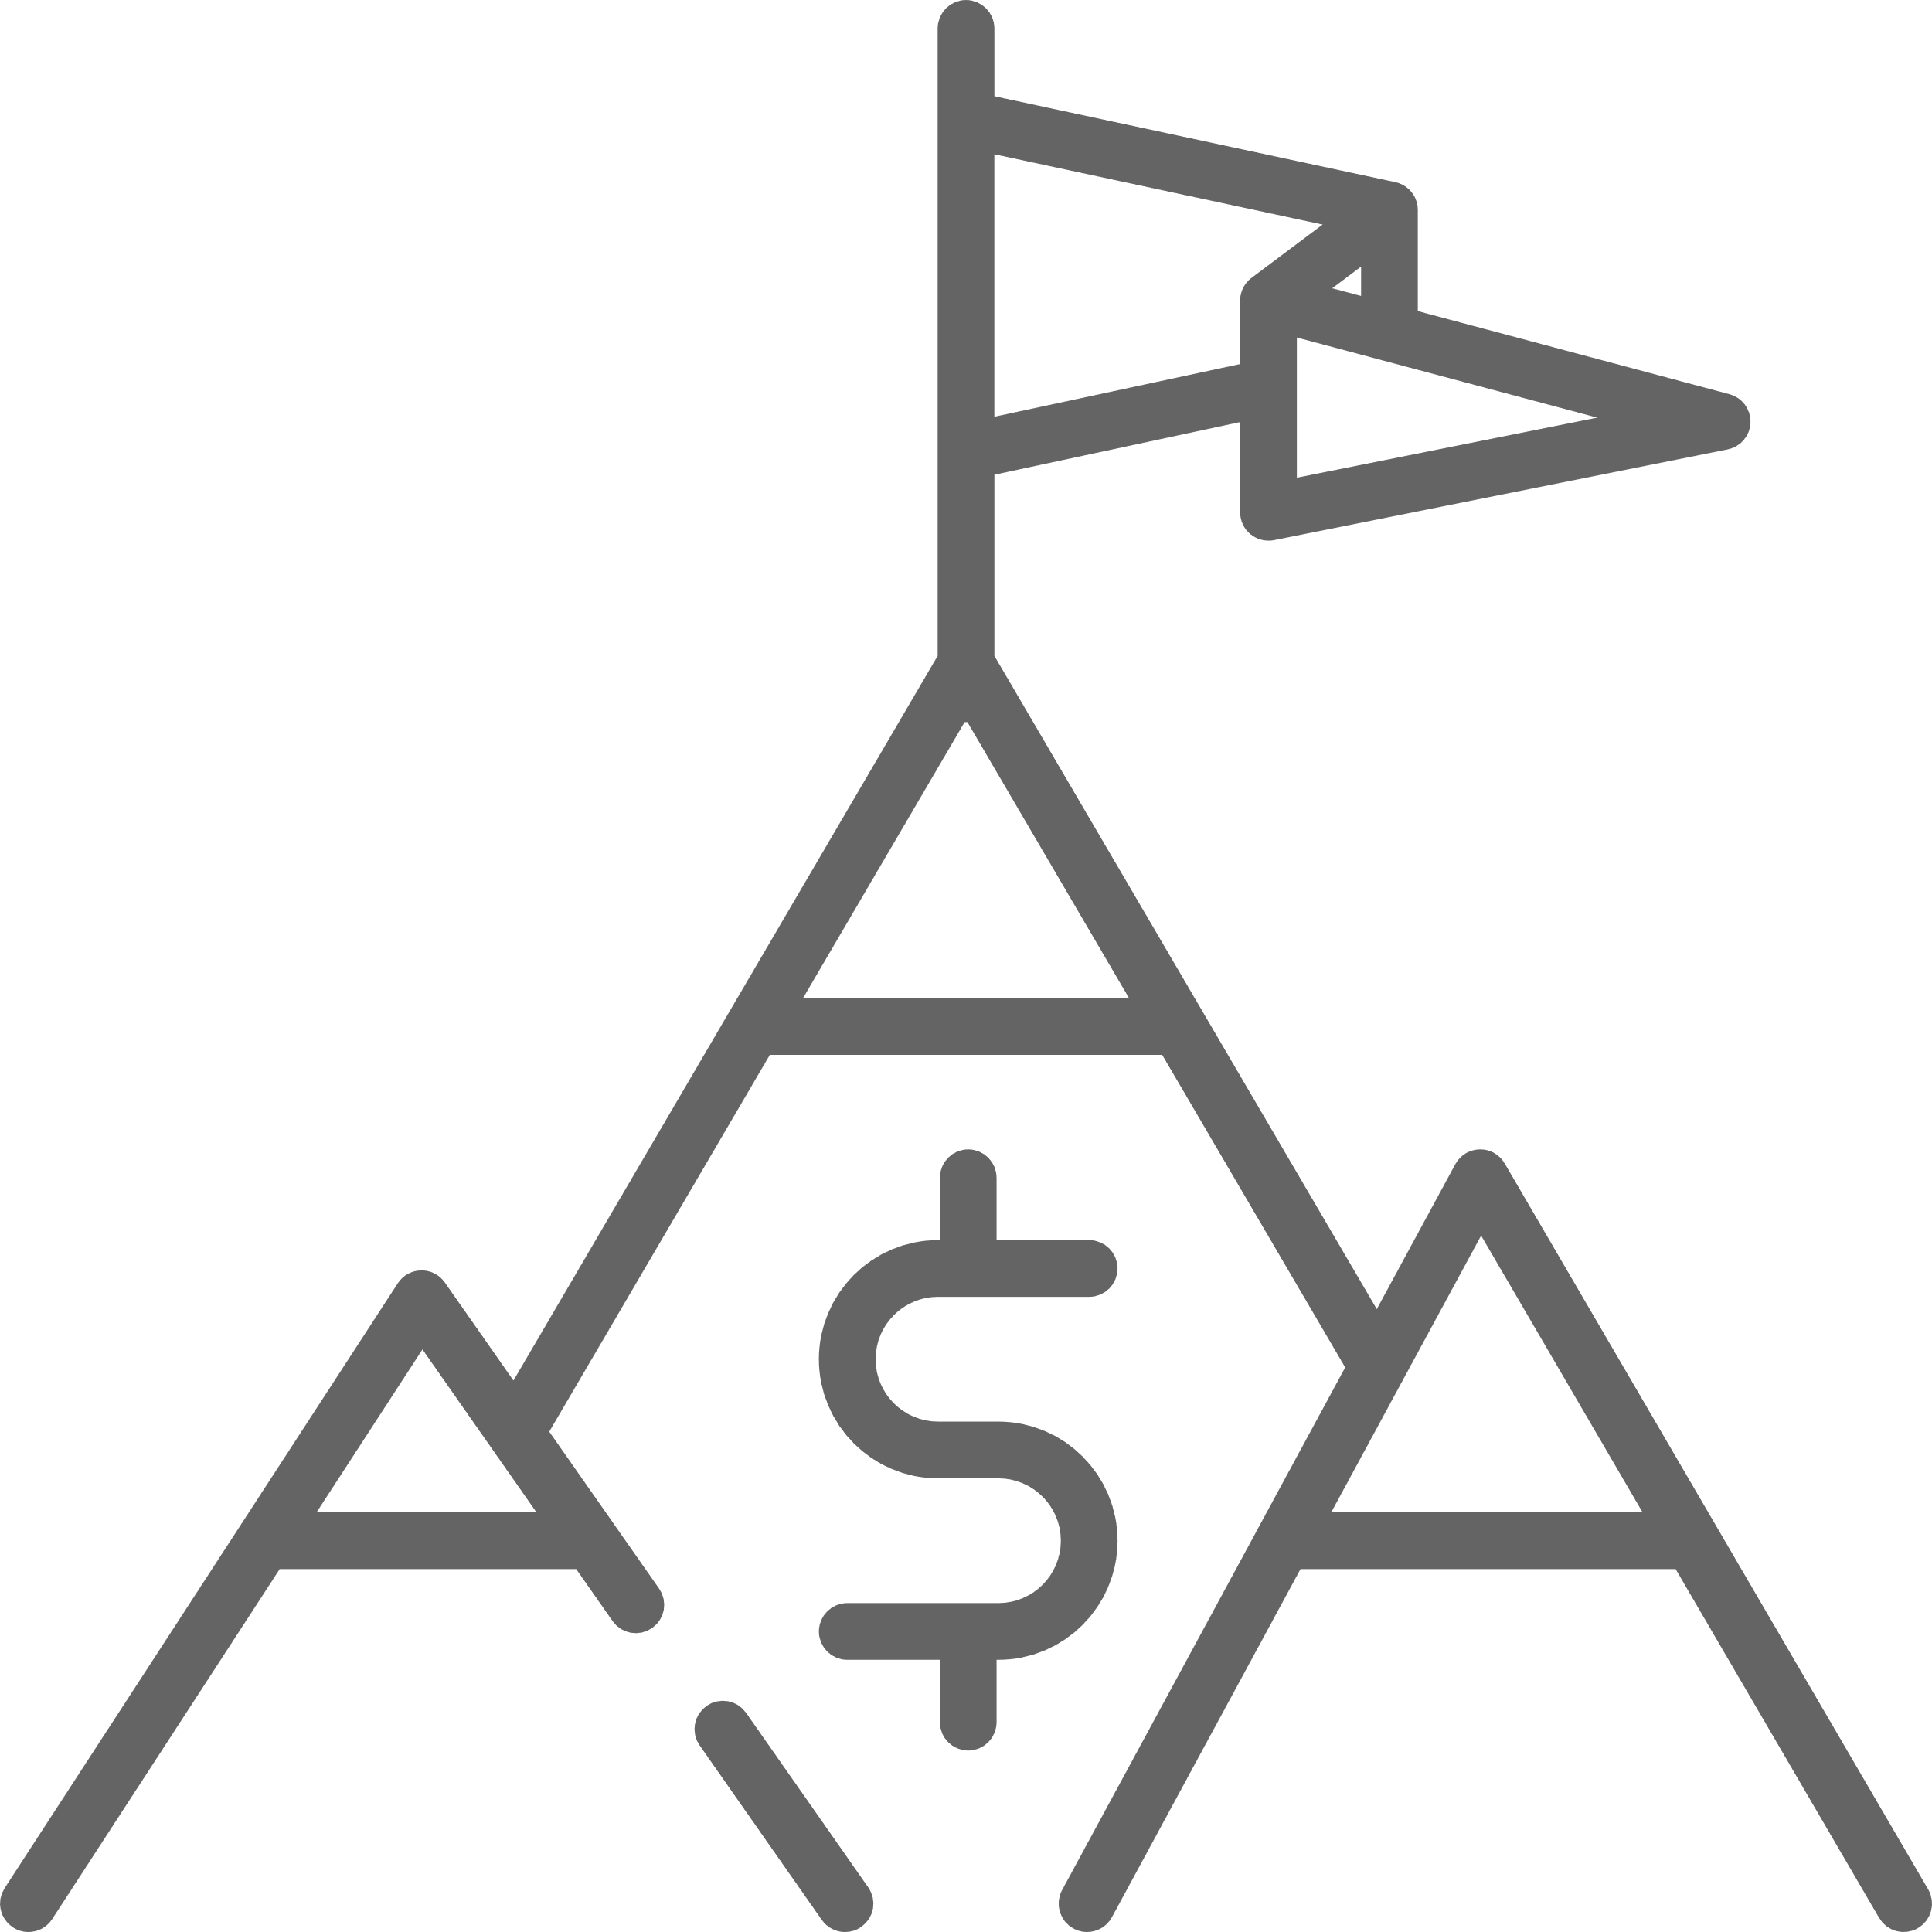

Our guiding principles for identification & prioritization of data related use-cases are robust, simple and maximize the value generated
Guiding Principles
Design thinking and user journey driven
Business Value driven
Customer Impacting
Optimization & Complexity
Agile Approach with Multi-disciplinary teams
By analyzing the user journey as a foundation through design thinking workshops, we would be able to understand, and advise on the prioritization of use cases from the customer’s point of view.
Use cases that have a direct impact on business value through increased profitability or monetizing data assets, increased cross-sell/ up-sell etc.
These can include the use cases with direct regulatory impact.
Use cases which have a significant impact on Customer experience, Customer or agent journeys, Customer retention and can be mapped to the overall journey.
Use cases that optimize current set of business processes. Complexity can be defined on the basis of
# of processes & sub-processes
# KDEs
# data domain
# data sources
# front end apps
Our team comprises of experts in business products, technology, campaign management, and data & analytics, with experience ranging from strategy to execution.
Agile processes harness change for the customer's competitive advantage

Slide 24
Use-cases would be prioritised against the business importance and ease of implementation with customer at the centre
Framework
Business Value – revenue & cost saving potential
High
- Revenue uplift
- Conversion ratio
- Xsell and upsell
- Retention
High Value
Rapid High Value
Business Value
+
use cases that optimize current set of business processes while being easy to implement
1
Volume – number of occurrences of the interaction
Volume
use cases that have a significant impact on
Customer experience
business value
+
Broken state - how ‘broken’ is the interaction today
2
Value to business
Broken State
Low Priority
Rapid Value
+
Customer Impact - importance of the interaction on customer experience
3
Customer Impact
use cases that have a direct impact on business value through increased profitability
+
4
Strategic intent – alignment to the strategic themes
Strategic Intent
Ease of Implementation
High
Order of priority
Data | + | Technology | + | Process

Slide 25
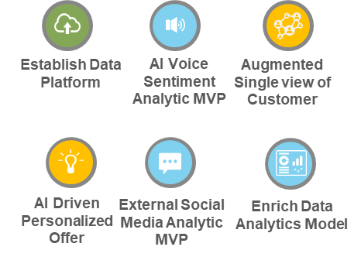
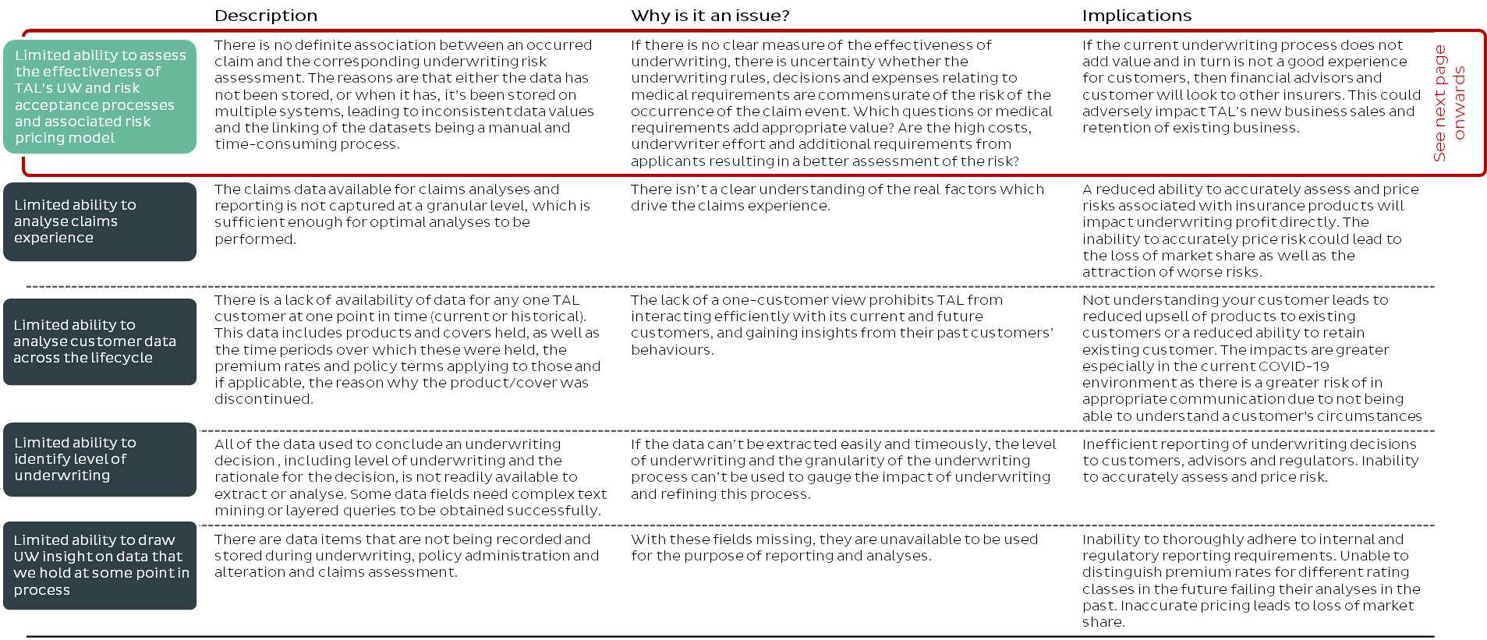
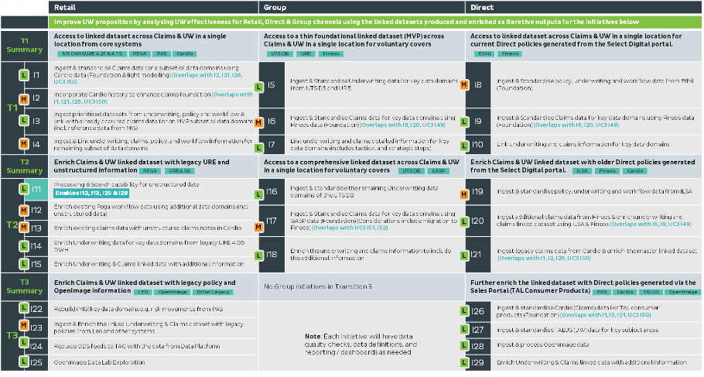
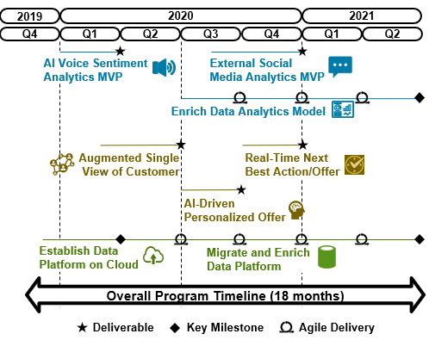
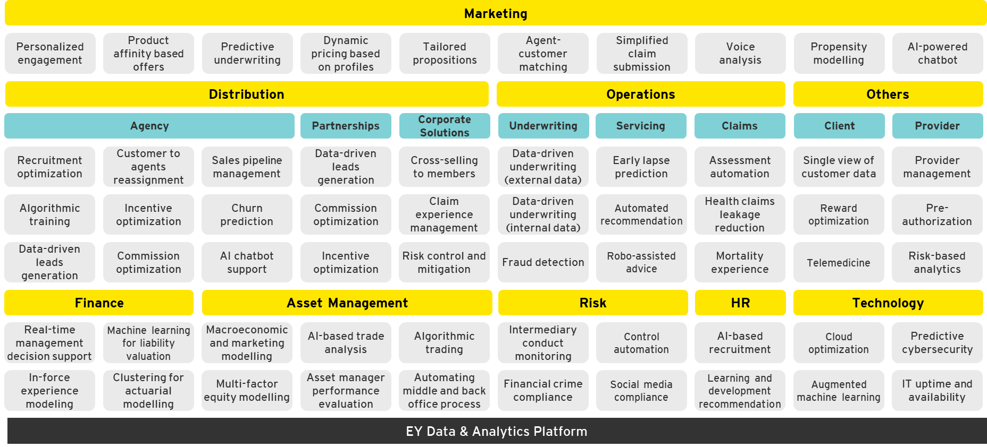
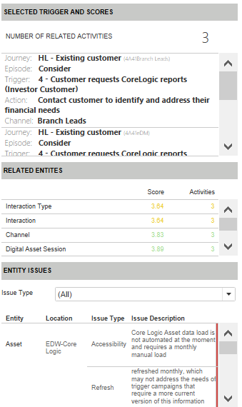
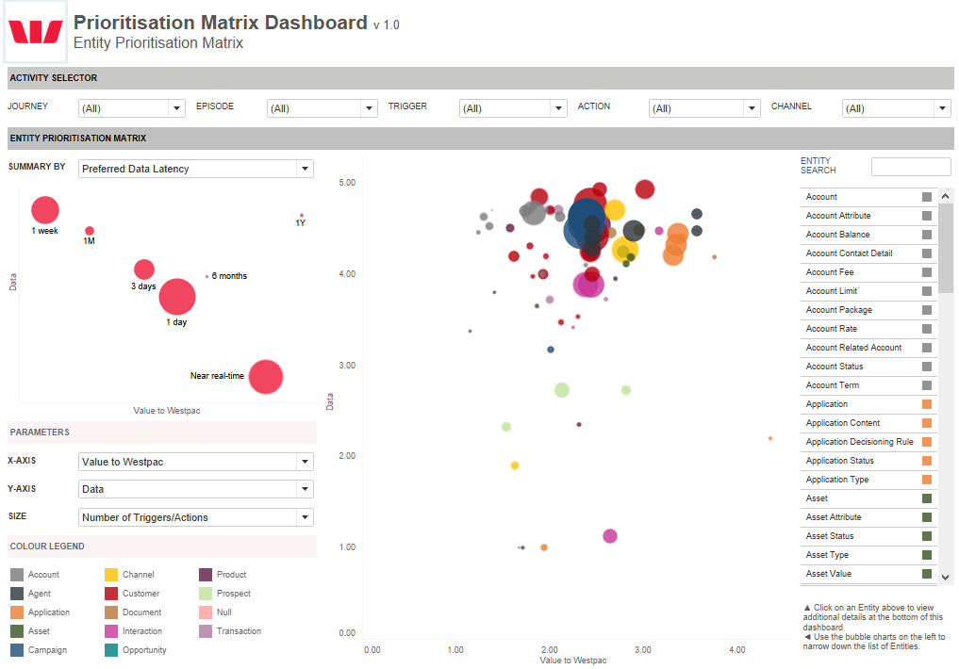
Use-cases would be identified using our Data & Analytics use-case libraries while prioritizing based on our Value, Impact & Complexity based framework
Approach
Inputs
Process
Outputs
ILLUSTRATIVE
Work Product: Use-Case Identification & Prioritization Report
Step 1: Identify the business use-cases along with their scope and value proposition to the customer
ILLUSTRATIVE
Step 2: Organize and run workshops with business teams to understand the activities performed across the information environment to come up with a list of prioritized use cases
AIAT’s list of Business Use-Cases
Step 3: Identify the corresponding Data related use-case by mapping to our vast use-case libraries for a quick turn-around
ILLUSTRATIVE
Step 4: Prioritize the use-cases based on our framework encompassing Business Value, Volume, Customer Impact & Strategic Intent
Use-Case Identification & Prioritization Report
This report will identify the different data related use-cases for the relevant business use-cases, while also prioritizing them based on our value, impact and complexity driven framework
Step 5: Develop use-case Identification & Prioritization Report that will be used to facilitate the implementation of selected use-cases by AIAT
High-level Program Timelines
EY Accelerator:
EY Data & Analytics use-case libraries
EY Use-case Prioritization Matrix

Slide 26
3.3
3.3 | Our Point of View & Approach
Data Platform Architecture
Data Platform Capability
Use Case Identification & Prioritization
Data Platform Architecture
Target Operating Model
IT Strategic Roadmap

Slide 27




Our guiding principles for the design of the Data Platform Architecture make it scalable, secure and timely
Guiding Principles
Reusable & Elastic
Timeliness
DevOps Enabled
Secure by Design
Standardization promotes reusability, and reusability results in lower implementation and maintenance costs.
With strong architectural and design standards in place, services are modularized and can be easily reused.
The infrastructure must be able to scale-out and scale-in rapidly based on demand
Necessary data is available in a timely fashion, with the relevant snapshot available whenever it is needed for the relevant processing.
Looking at the use-case requirements, we avail the data in a way it would be required to meet business objectives.
There is a fine balance between instant availability of data and unnecessary overloading of the network, and our experience guides us towards the optimal design.
A DevOps enabled environment is critical for the development and provisioning of resources needed to support the Data Platform.
This capability is also foundational – During the data training and modelling process, the same set of infrastructure or data will need to be provisioned repetitively. The DevOps cycle will help to accelerate the process and reduce human errors.
An approach that formalizes how security controls are being automated, secured and audited from its software design.
The future of application development and data consumption will build on microservices and RESTful API calls. The security thinking as a guiding principle is to ensure that all services created within the platform should be authenticated and secured.

Slide 28
We will analyze to the prioritized use-cases to identify the need for Azure ML vis-à-vis Data Science Lab – VM based on scalability, compute and model management
Framework
Data Augmentation & Labelling
Micro-Services /APIs
Integration
Analytics
Compute
Data Store
Automated ML
Model Monitoring
Dependency Handling
Distribute Data
Visualisation Portal
Real-time Event Streams
Data Exploration| Data engineering
Model/ Feature Repository
Deployment pipeline
Operational Portal
Resource Scaling & Management
Cluster Provisioning
AI/ML Capable Lab tools
Visualisation plugins
Billing
Code Repository
Lab Storage
Access Security
Failure Handling
Visualisation apps
CRM
Data Science DevOps
Decisioning
Visual Discovery
Data-Pipeline Version Control
Model Management
ModelOps
Workflows
Static Rules
Dynamic Rules
Data Discovery
Pre-Trained Models
Decision Repository
Elastic Search
Version Control
CI/CD
Create & Register Image
Deploy Image
Image
Collaboration
Text
OCR / Text Extraction
Data Ops
Docker Image Support & Container Services
Monitoring & Logging
Notebooks
Speech
IntelliSense Support
Multi-Lingual Modelling
Backup
Language
Model Fairness
Software & ML Frameworks
Search Service
Python SDK
R SDK
Visualization - JS
Hadoop / Spark
Development Tools & IDEs
Data Extracts
Image Segmentation
Asynchronous / Synchronous Services
Data Pub/Sub
SpeechModels
Customizable Deep Learning Development Frameworks
API
Cognitive Services and OSIT Modelling Frameworks
Application & Access Security
Infrastructure & Operations

Slide 29
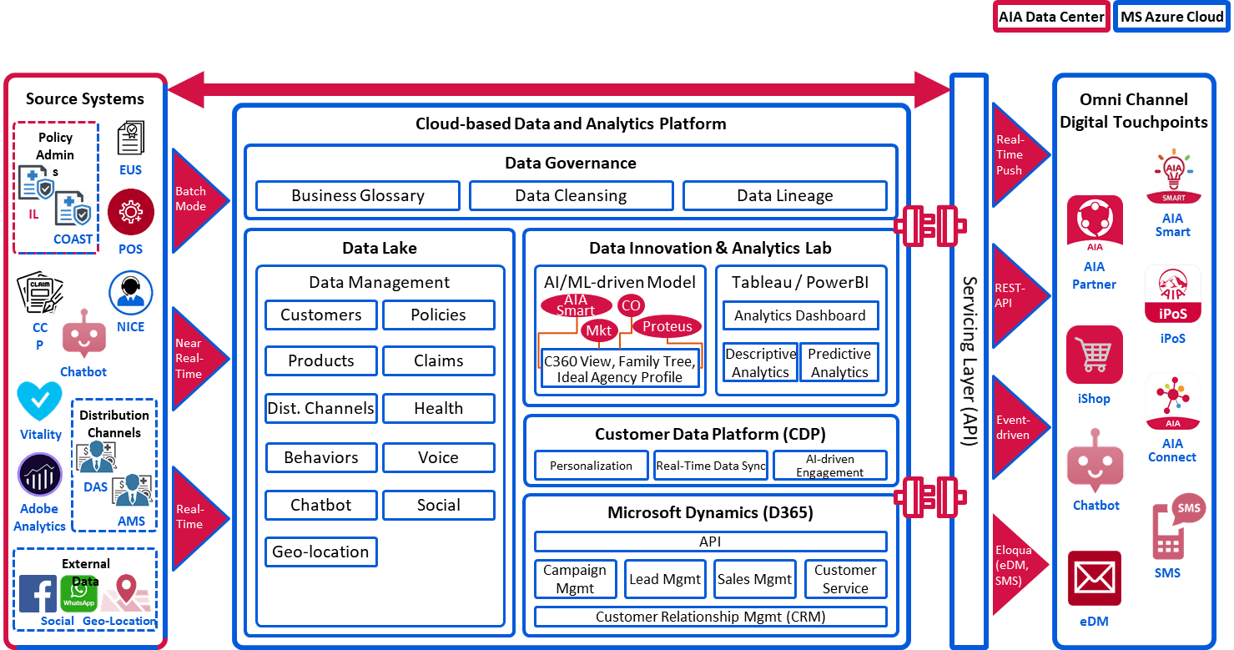
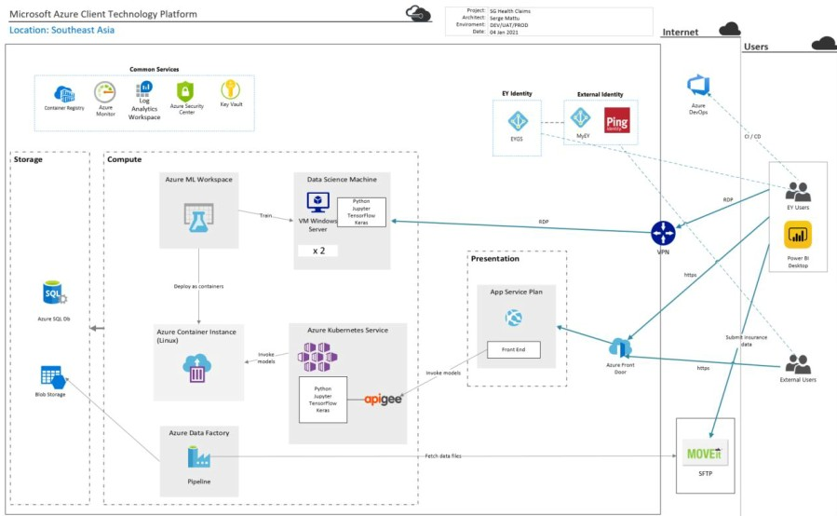
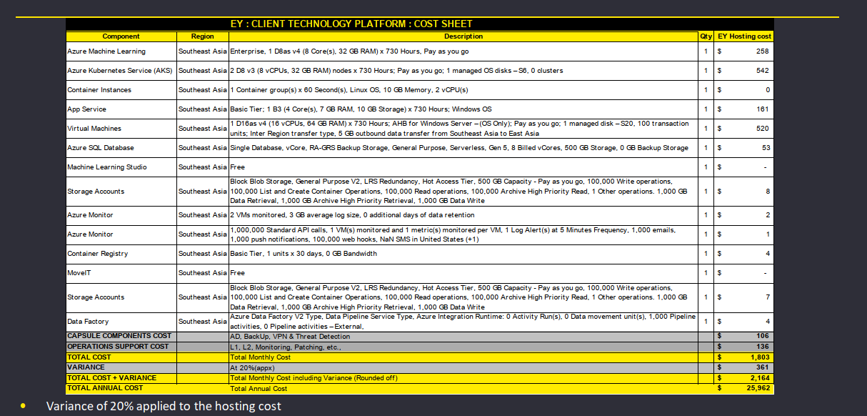
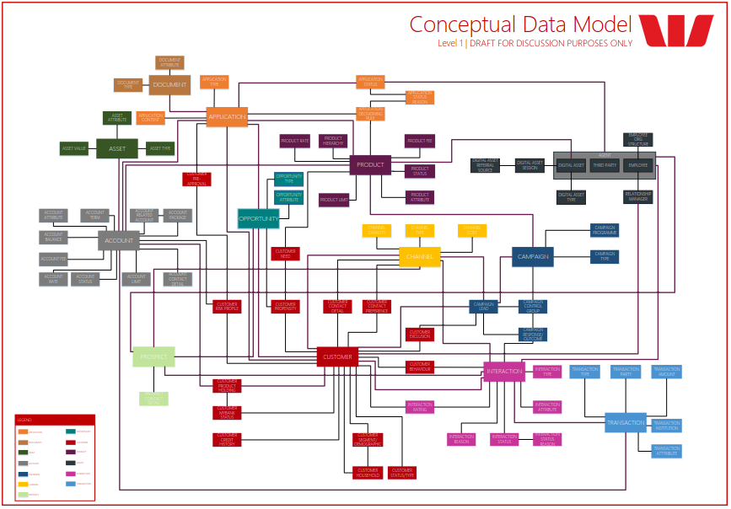
Analysis of current Data Platform coupled with capabilities required for prioritized use-cases would help deliver the Target Data Architecture & Implementation cost
Approach
Inputs
Process
Outputs
ILLUSTRATIVE
Work Product: Data Platform Capability Gap Report
Step 1: Input Gap Analysis of the AIAT current Data Platform
ILLUSTRATIVE
Step 2: Identify capabilities required for enabling the list of prioritized use-cases
AIAT’s Data Platform Gap Analysis
Step 3: Analyze the identified capabilities to recommend on Data Science Lab – VM vs Azure ML
Data Platform Architecture Design
ILLUSTRATIVE
Step 4: Design the Data Platform Architecture for target state with required capabilities & governance.
ILLUSTRATIVE
Step 5: Identify the relevant Azure Modules and their implementation cost required
Azure’s module & implementation cost
Capabilities for prioritized use-cases
EY Accelerator:
EY Next Generation Data Platform Architecture
EY Client Technology Azure Solution Architecture

Slide 30

3.4
3.4 | Our Point of View & Approach
Target Operating Model
Data Platform Capability
Use Case Identification & Prioritization
Data Platform Architecture
Target Operating Model
IT Strategic Roadmap

Slide 31
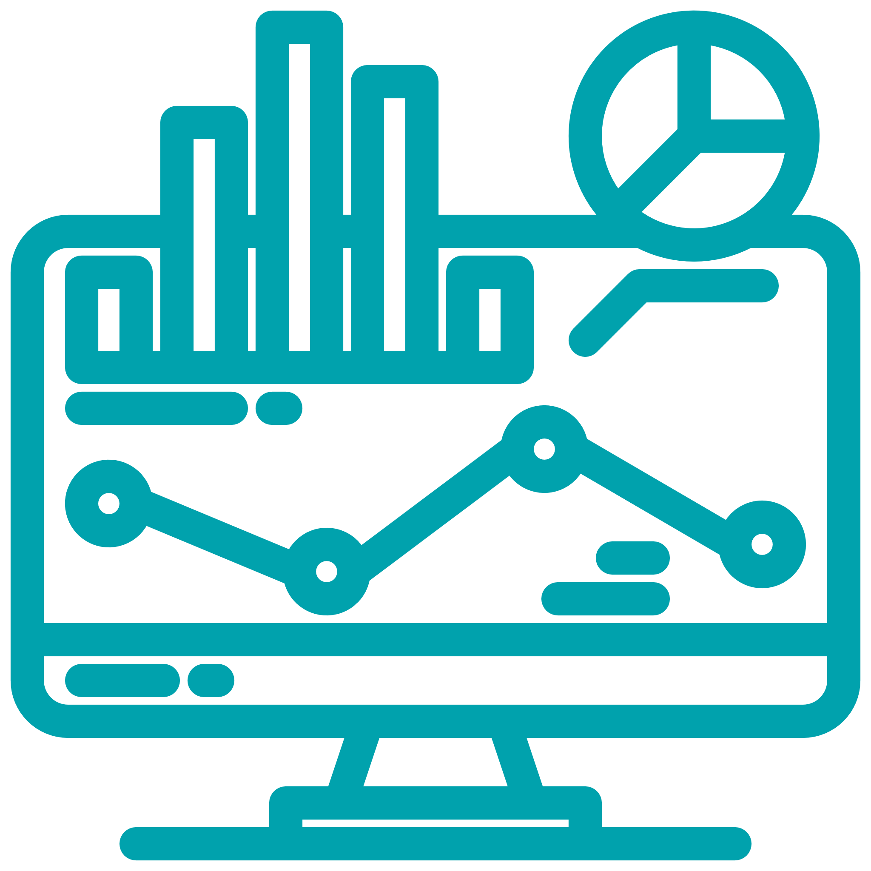



The target operating model will encompass with roles and responsibilities that would drive AIAT to deliver data related use cases
Framework
TOM Capabilities
Key Processes
Skills Required
The TOM is comprised of a set of Business, Analytics, Data Management & Technology capabilities, underpinned by key processes and roles, and the required skills to execute them.
Advanced Data Analytics
Self-Service Visualization
Metadata Management
Integrated Coding
Shared and Documented Coding
Scalability per Query
Data Governance
Data Quality
Data Privacy
Data Engineering
Big Data Lake Modelling
Big Data Lake Architecture
Big Data Lake Management
Data Science
Governance
Data Analytics
Data Management
Business Requirements
Data Management
Data Sourcing & Ingestion
Data Acquisition
Data Synthesis
Data Analytics &
Advanced Analytics
Data Governance
Data Security
Data Provisioning
Data Ingestion/ Integration
Example of TOM Roles*
Manage Project Lifecycle
Business Analysts
Database Admin
Big Data Lake Architects
Data Modeler for Big Data
DevSecOps Engineer
Data Security & Compliance Admin
Data Analysts
Data Scientists (AI/ML)
Data Visualization Experts
Platform Management
Training & Development
Support
Communications, Newsletters, User Groups
Manage Change
* List is not exhaustive

Slide 32
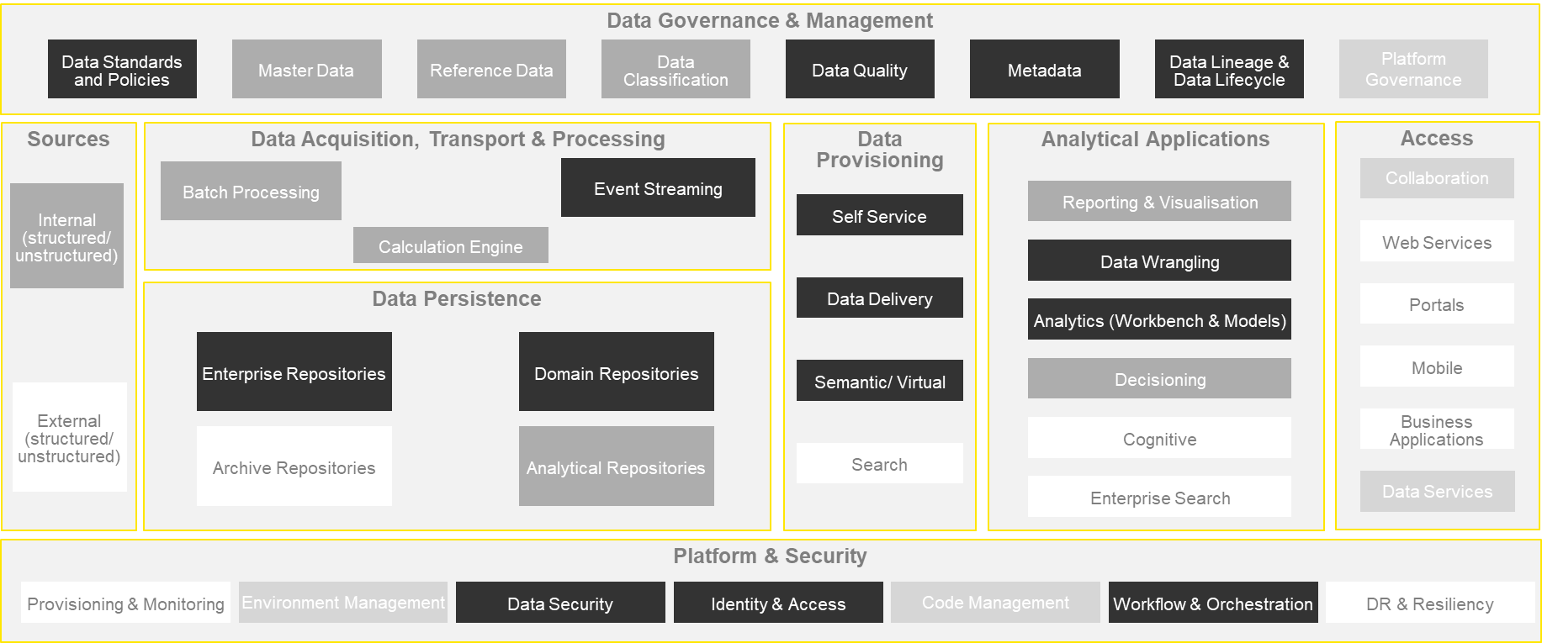
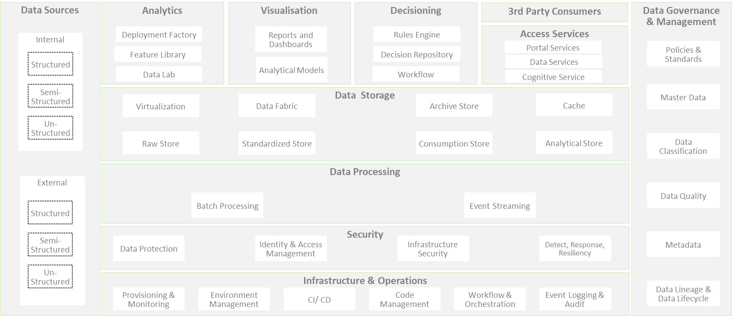
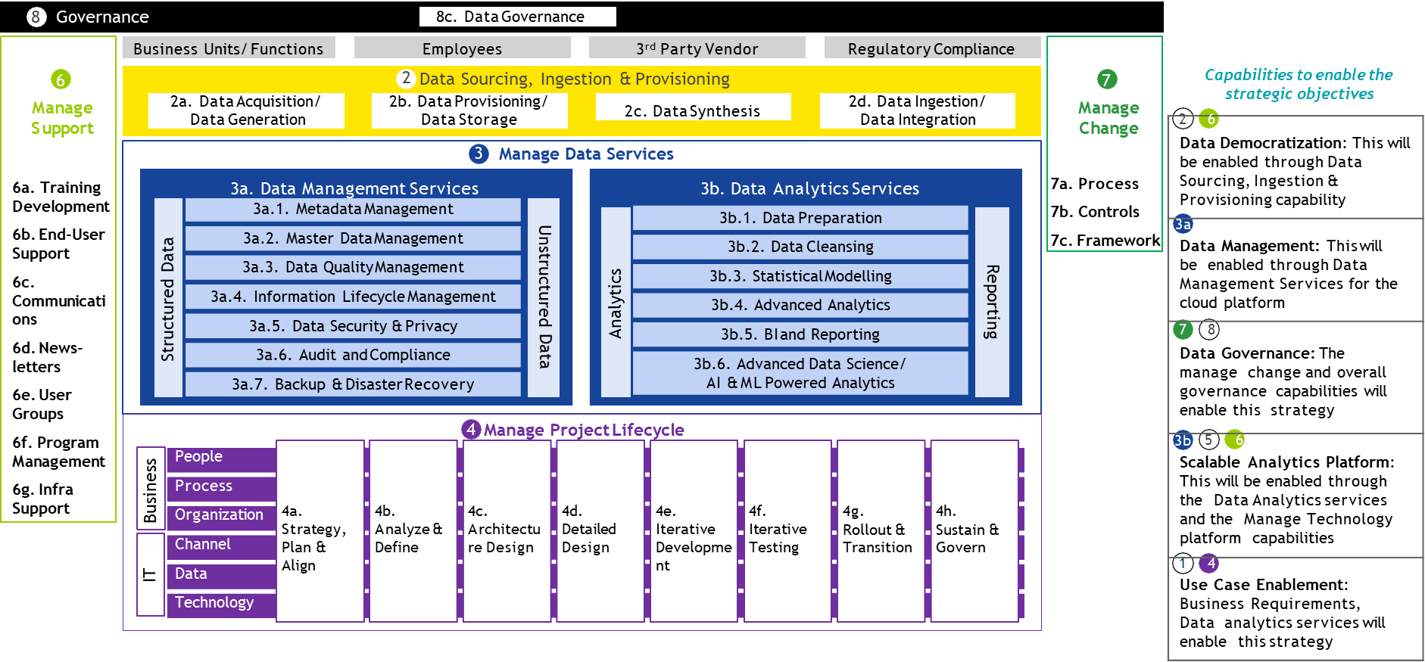
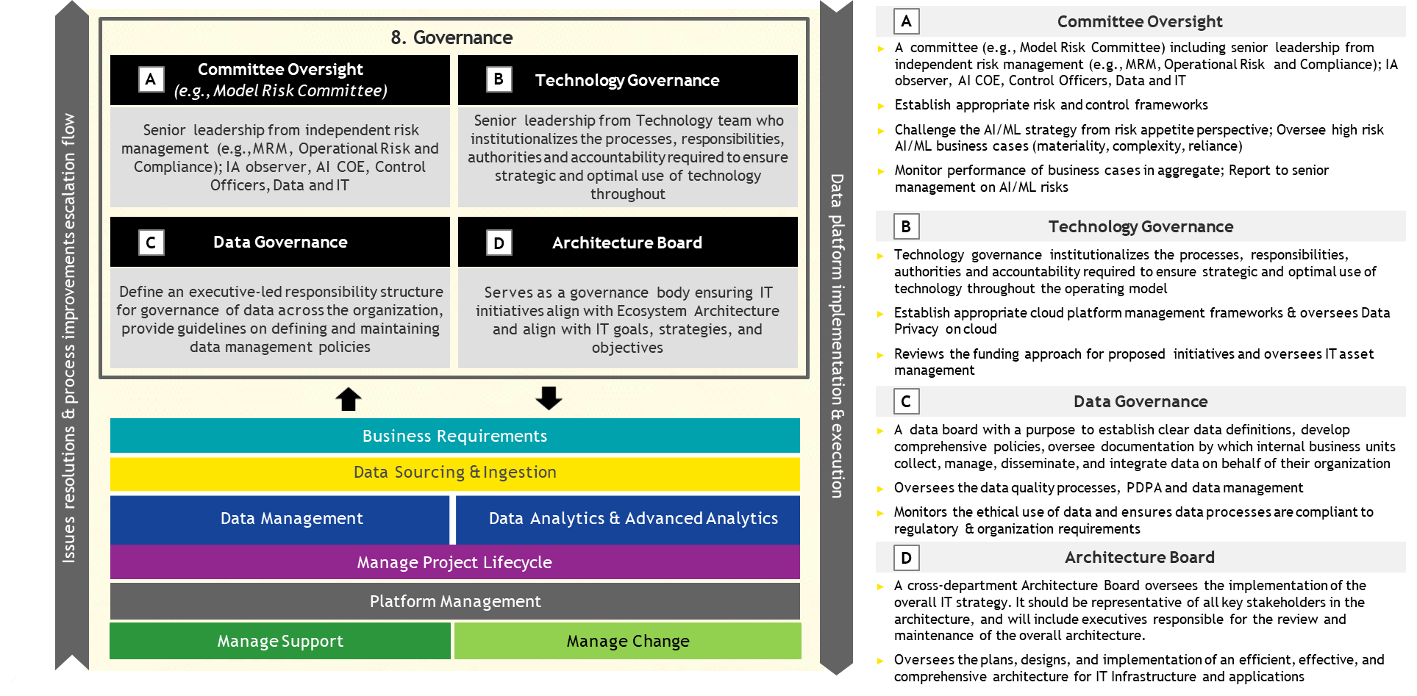
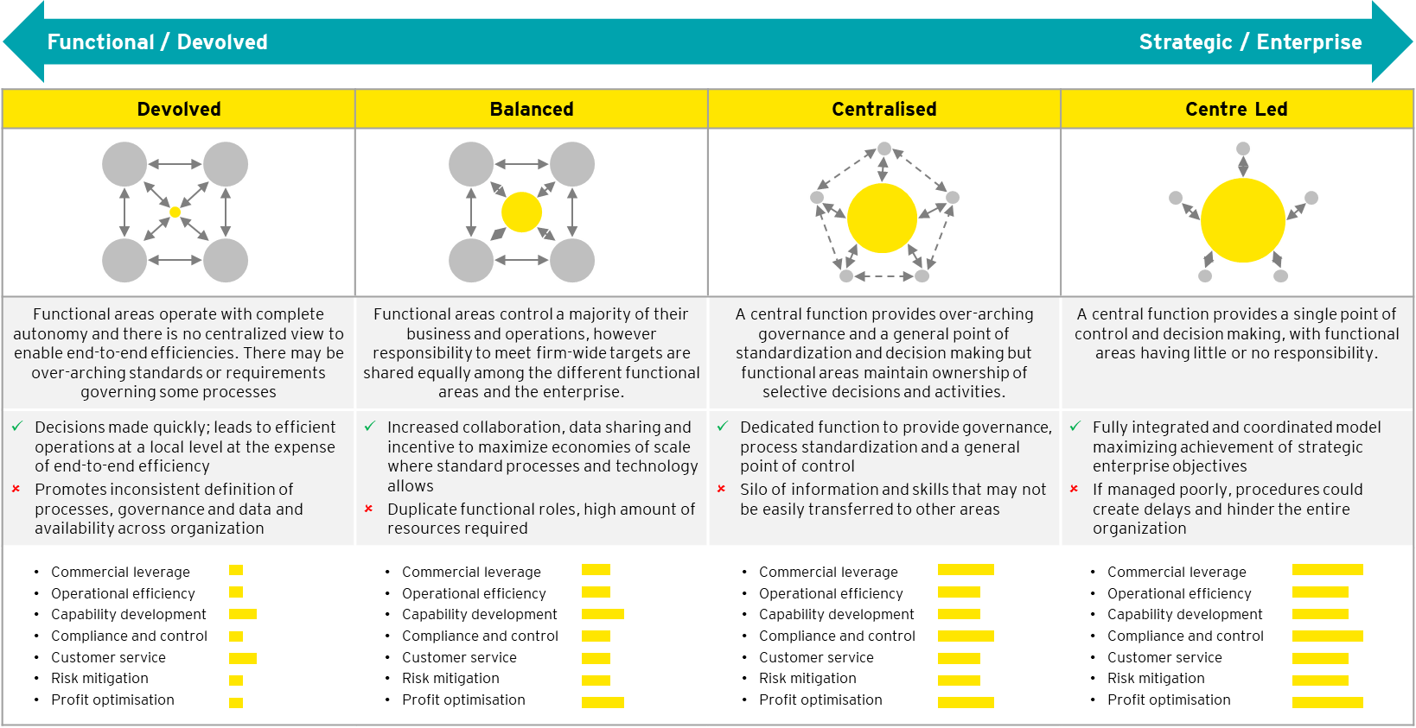
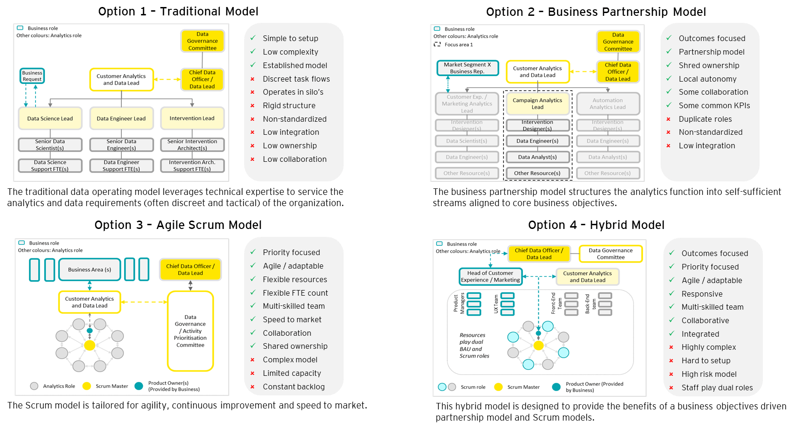
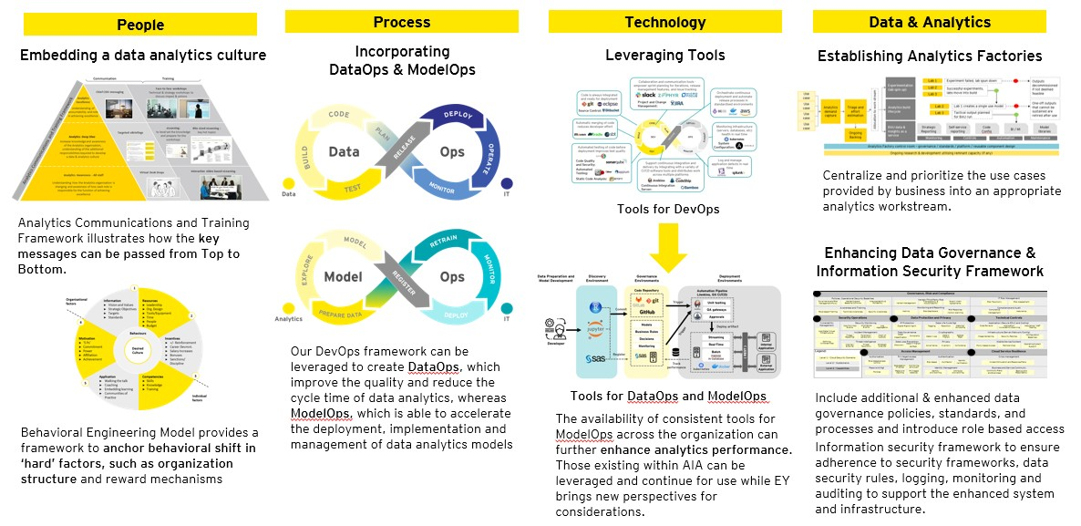
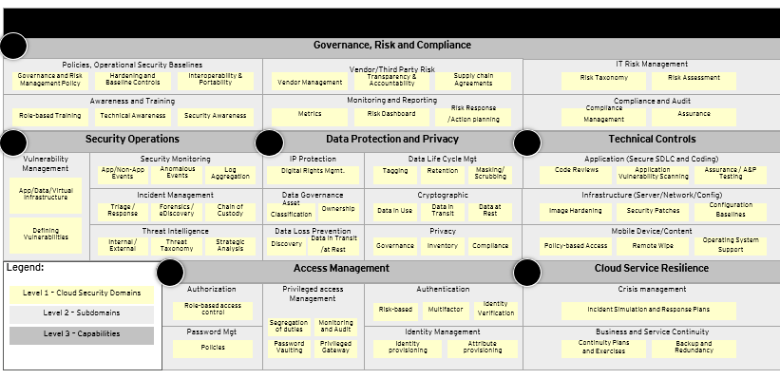
The analysis on data platform capabilities will allow us to design and propose a target operating model that will best suit the objectives of TDA
Approach
Inputs
Process
Outputs
ILLUSTRATIVE
Work Product: High-level organization & operating model
Step 1: Use the data platform capabilities analysis to identify roles and responsibilities, which need to be enhanced for data flatform
ILLUSTRATIVE
Step 2: Set up a workshop with key stakeholders to identify the choice of centralization and management (e.g. traditional or agile)
Data Platform Capability Analysis
Step 3: Analyze the AIAT policy, standard & procedure framework focusing on Data Governance, Data Quality, Data Usage, Data Management & Data Analytics capabilities
ILLUSTRATIVE
Design of the Organization & Operating Model for Data Platform
Step 4: Design the data platform specific organization structure, roles & responsibilities needed to drive Technology, Digital & Analytics Initiative
This report will propose the target operating model, organizational structure with roles and responsibilities for data platform that will best fit with the current state and objectives of AIAT.
AIAT’s choice of centralization & analytics operating Model
EY Accelerator:
EY Data & Analytics Enablers for TOM implementation with Data Ops, ModelOps & Analytics Factory designs
EY Data Management & Governance Framework
EY Information Security Framework

Slide 33
3.5
3.5 | Our Point of View & Approach
IT Strategic Roadmap
Data Platform Capability
Use Case Identification & Prioritization
Data Platform Architecture
Target Operating Model
IT Strategic Roadmap

Slide 34
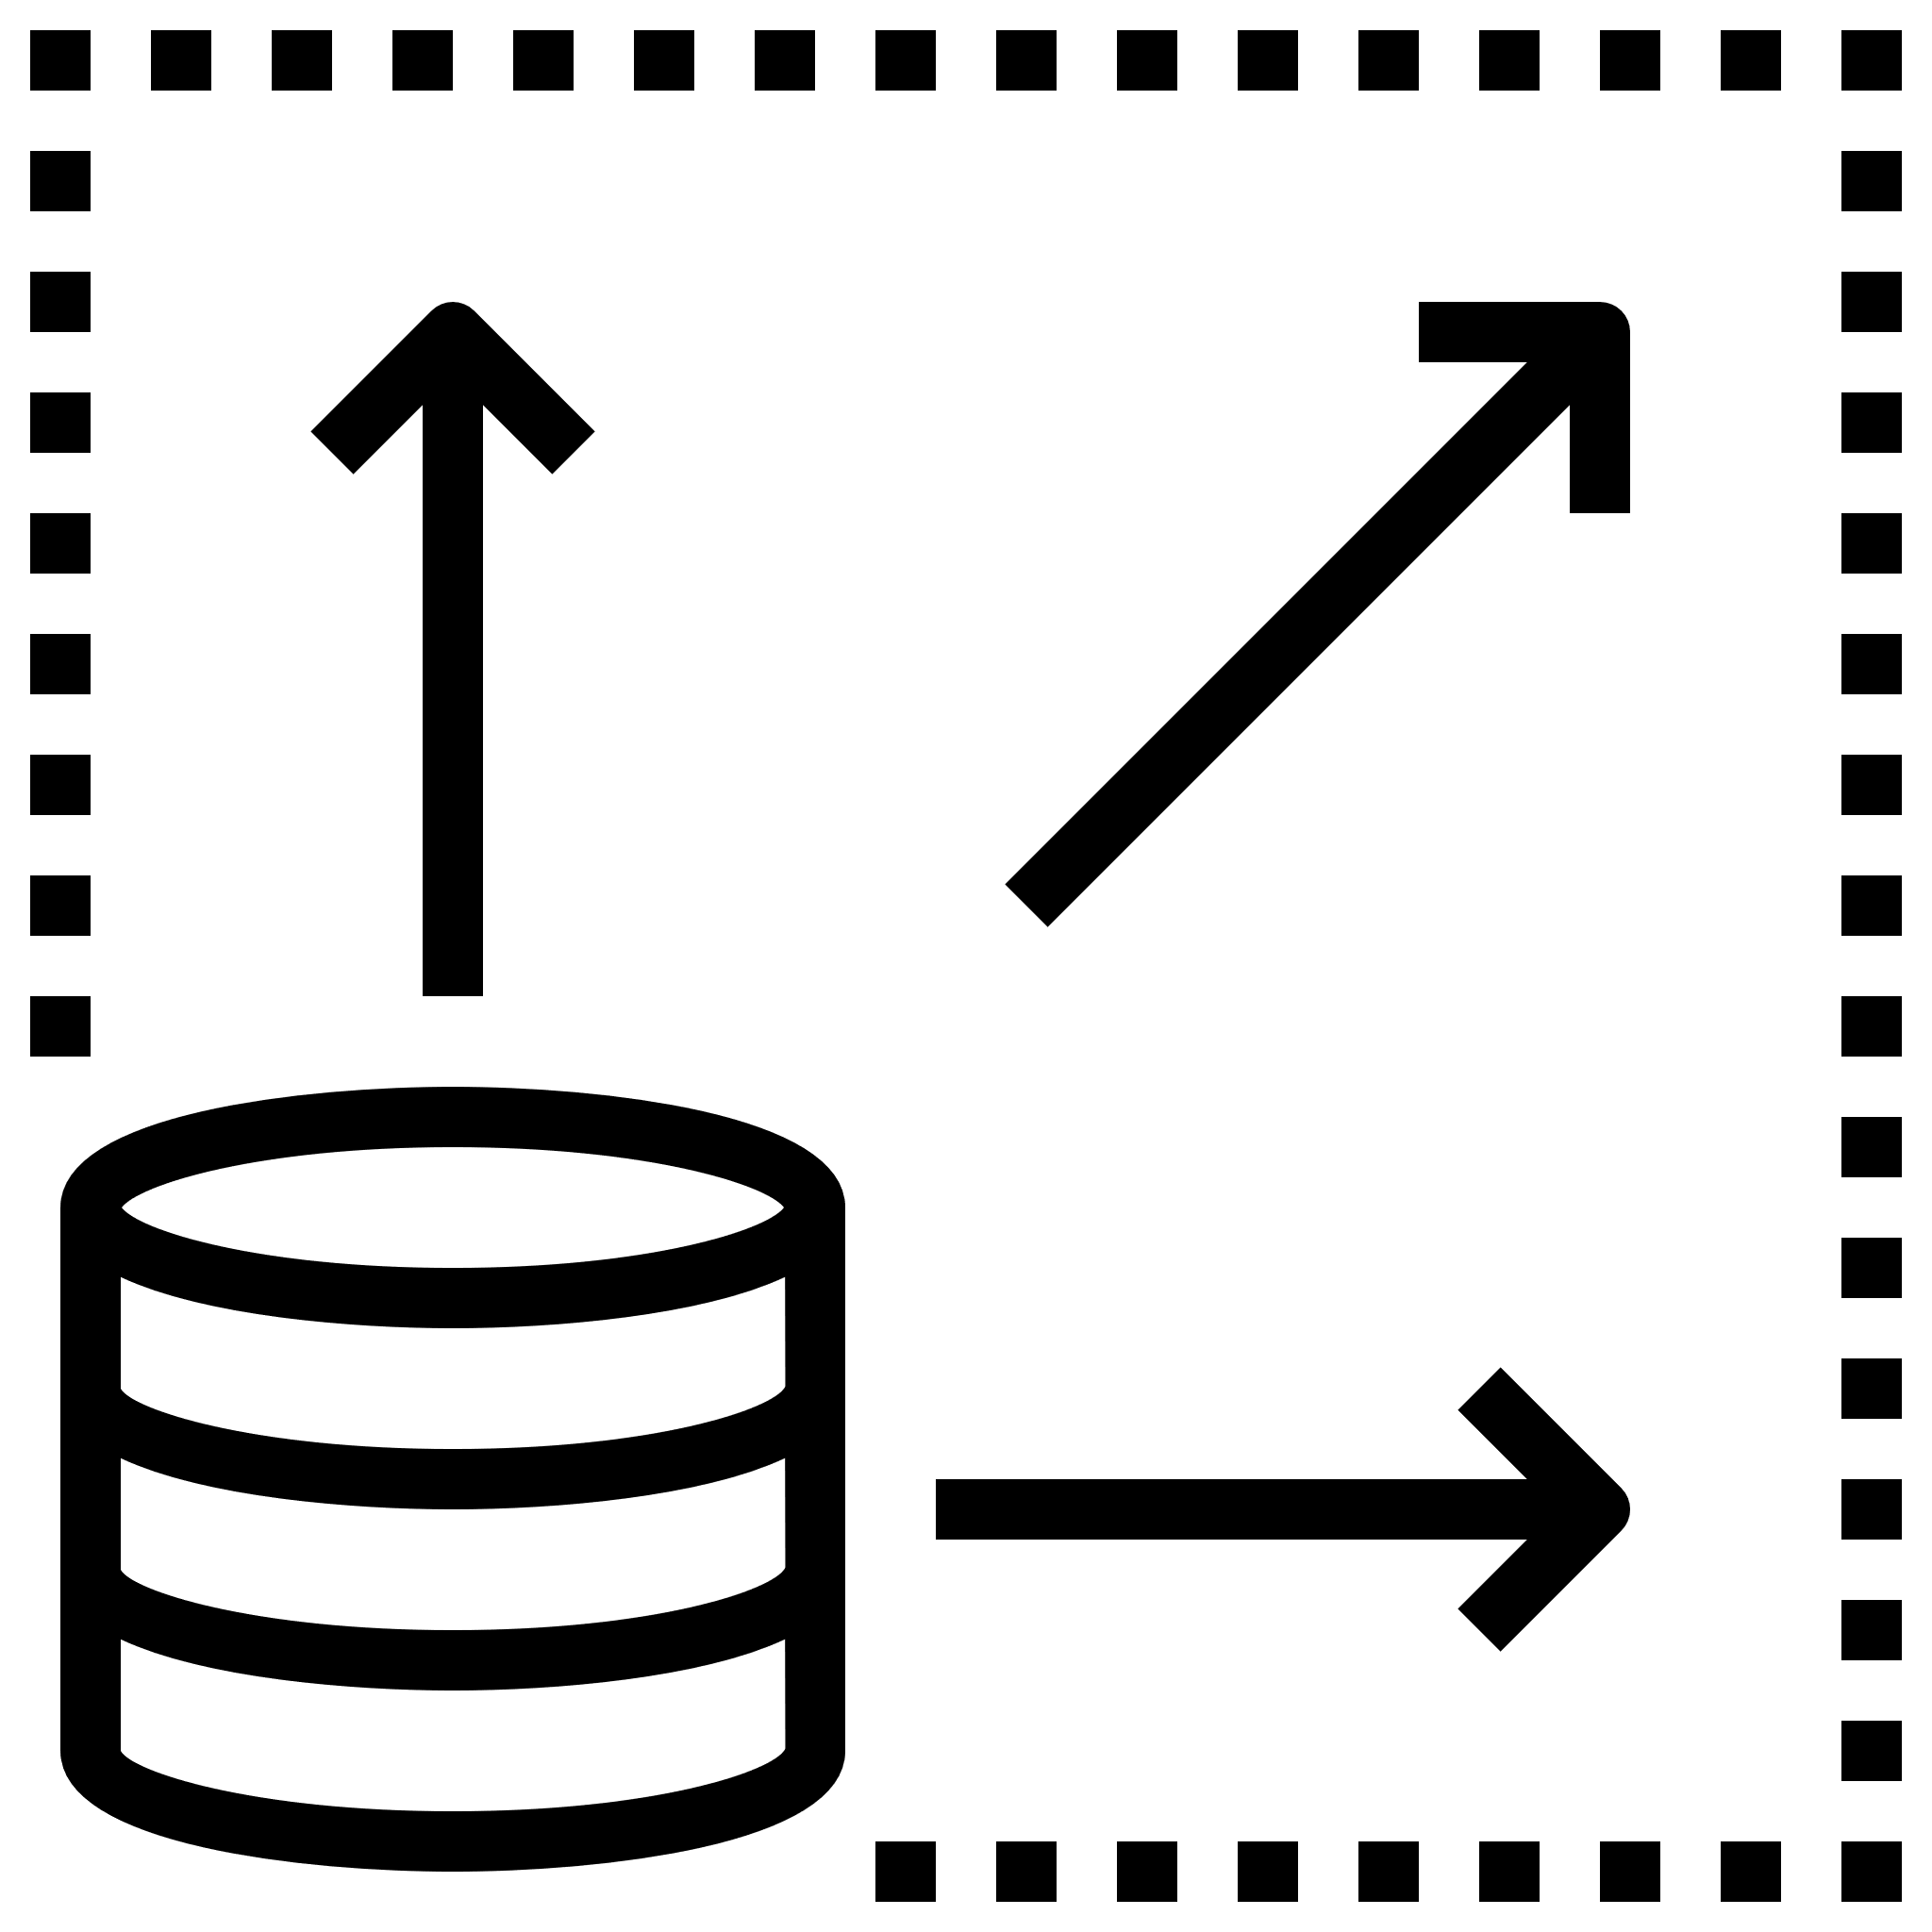

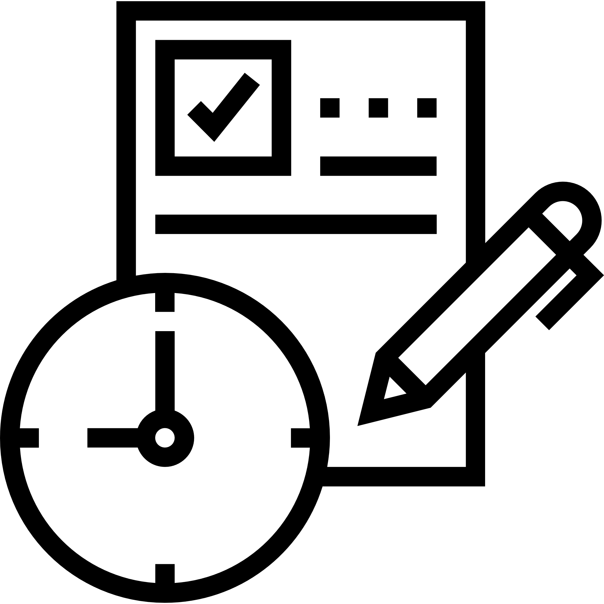







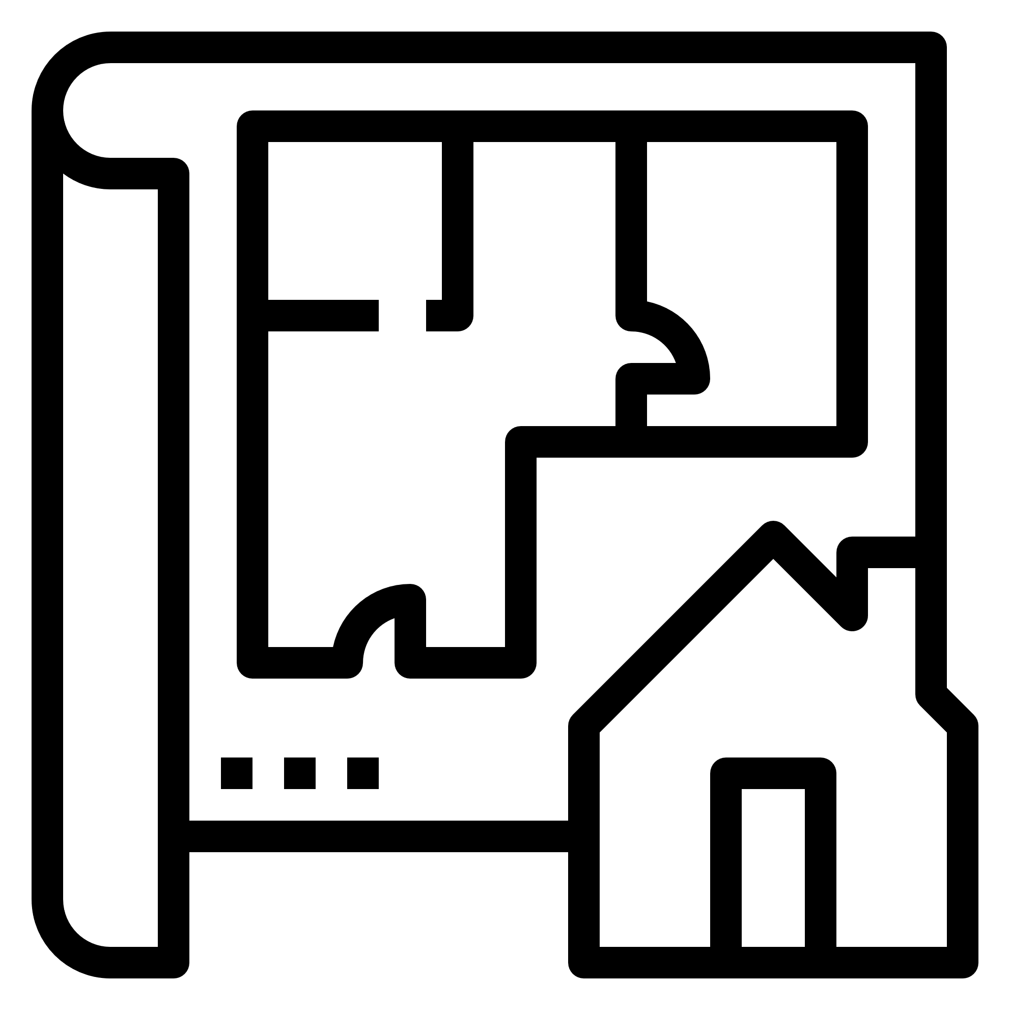
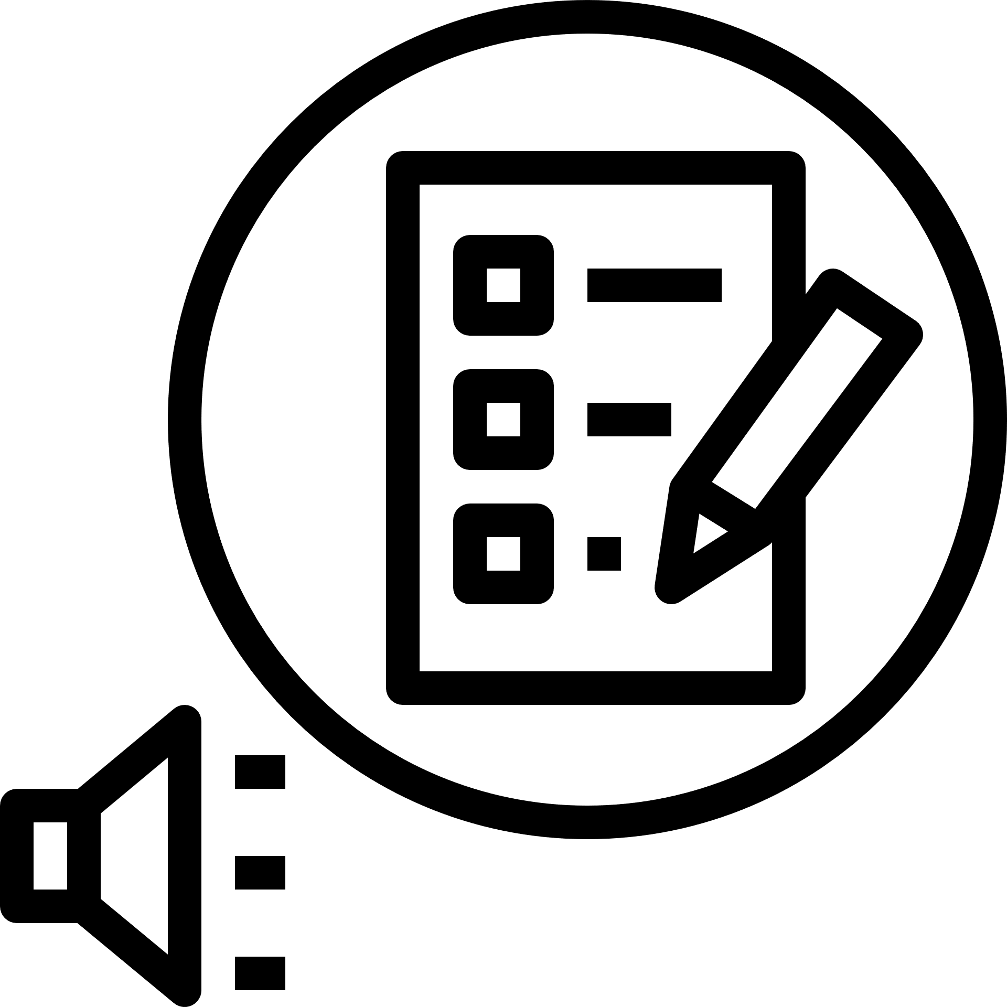
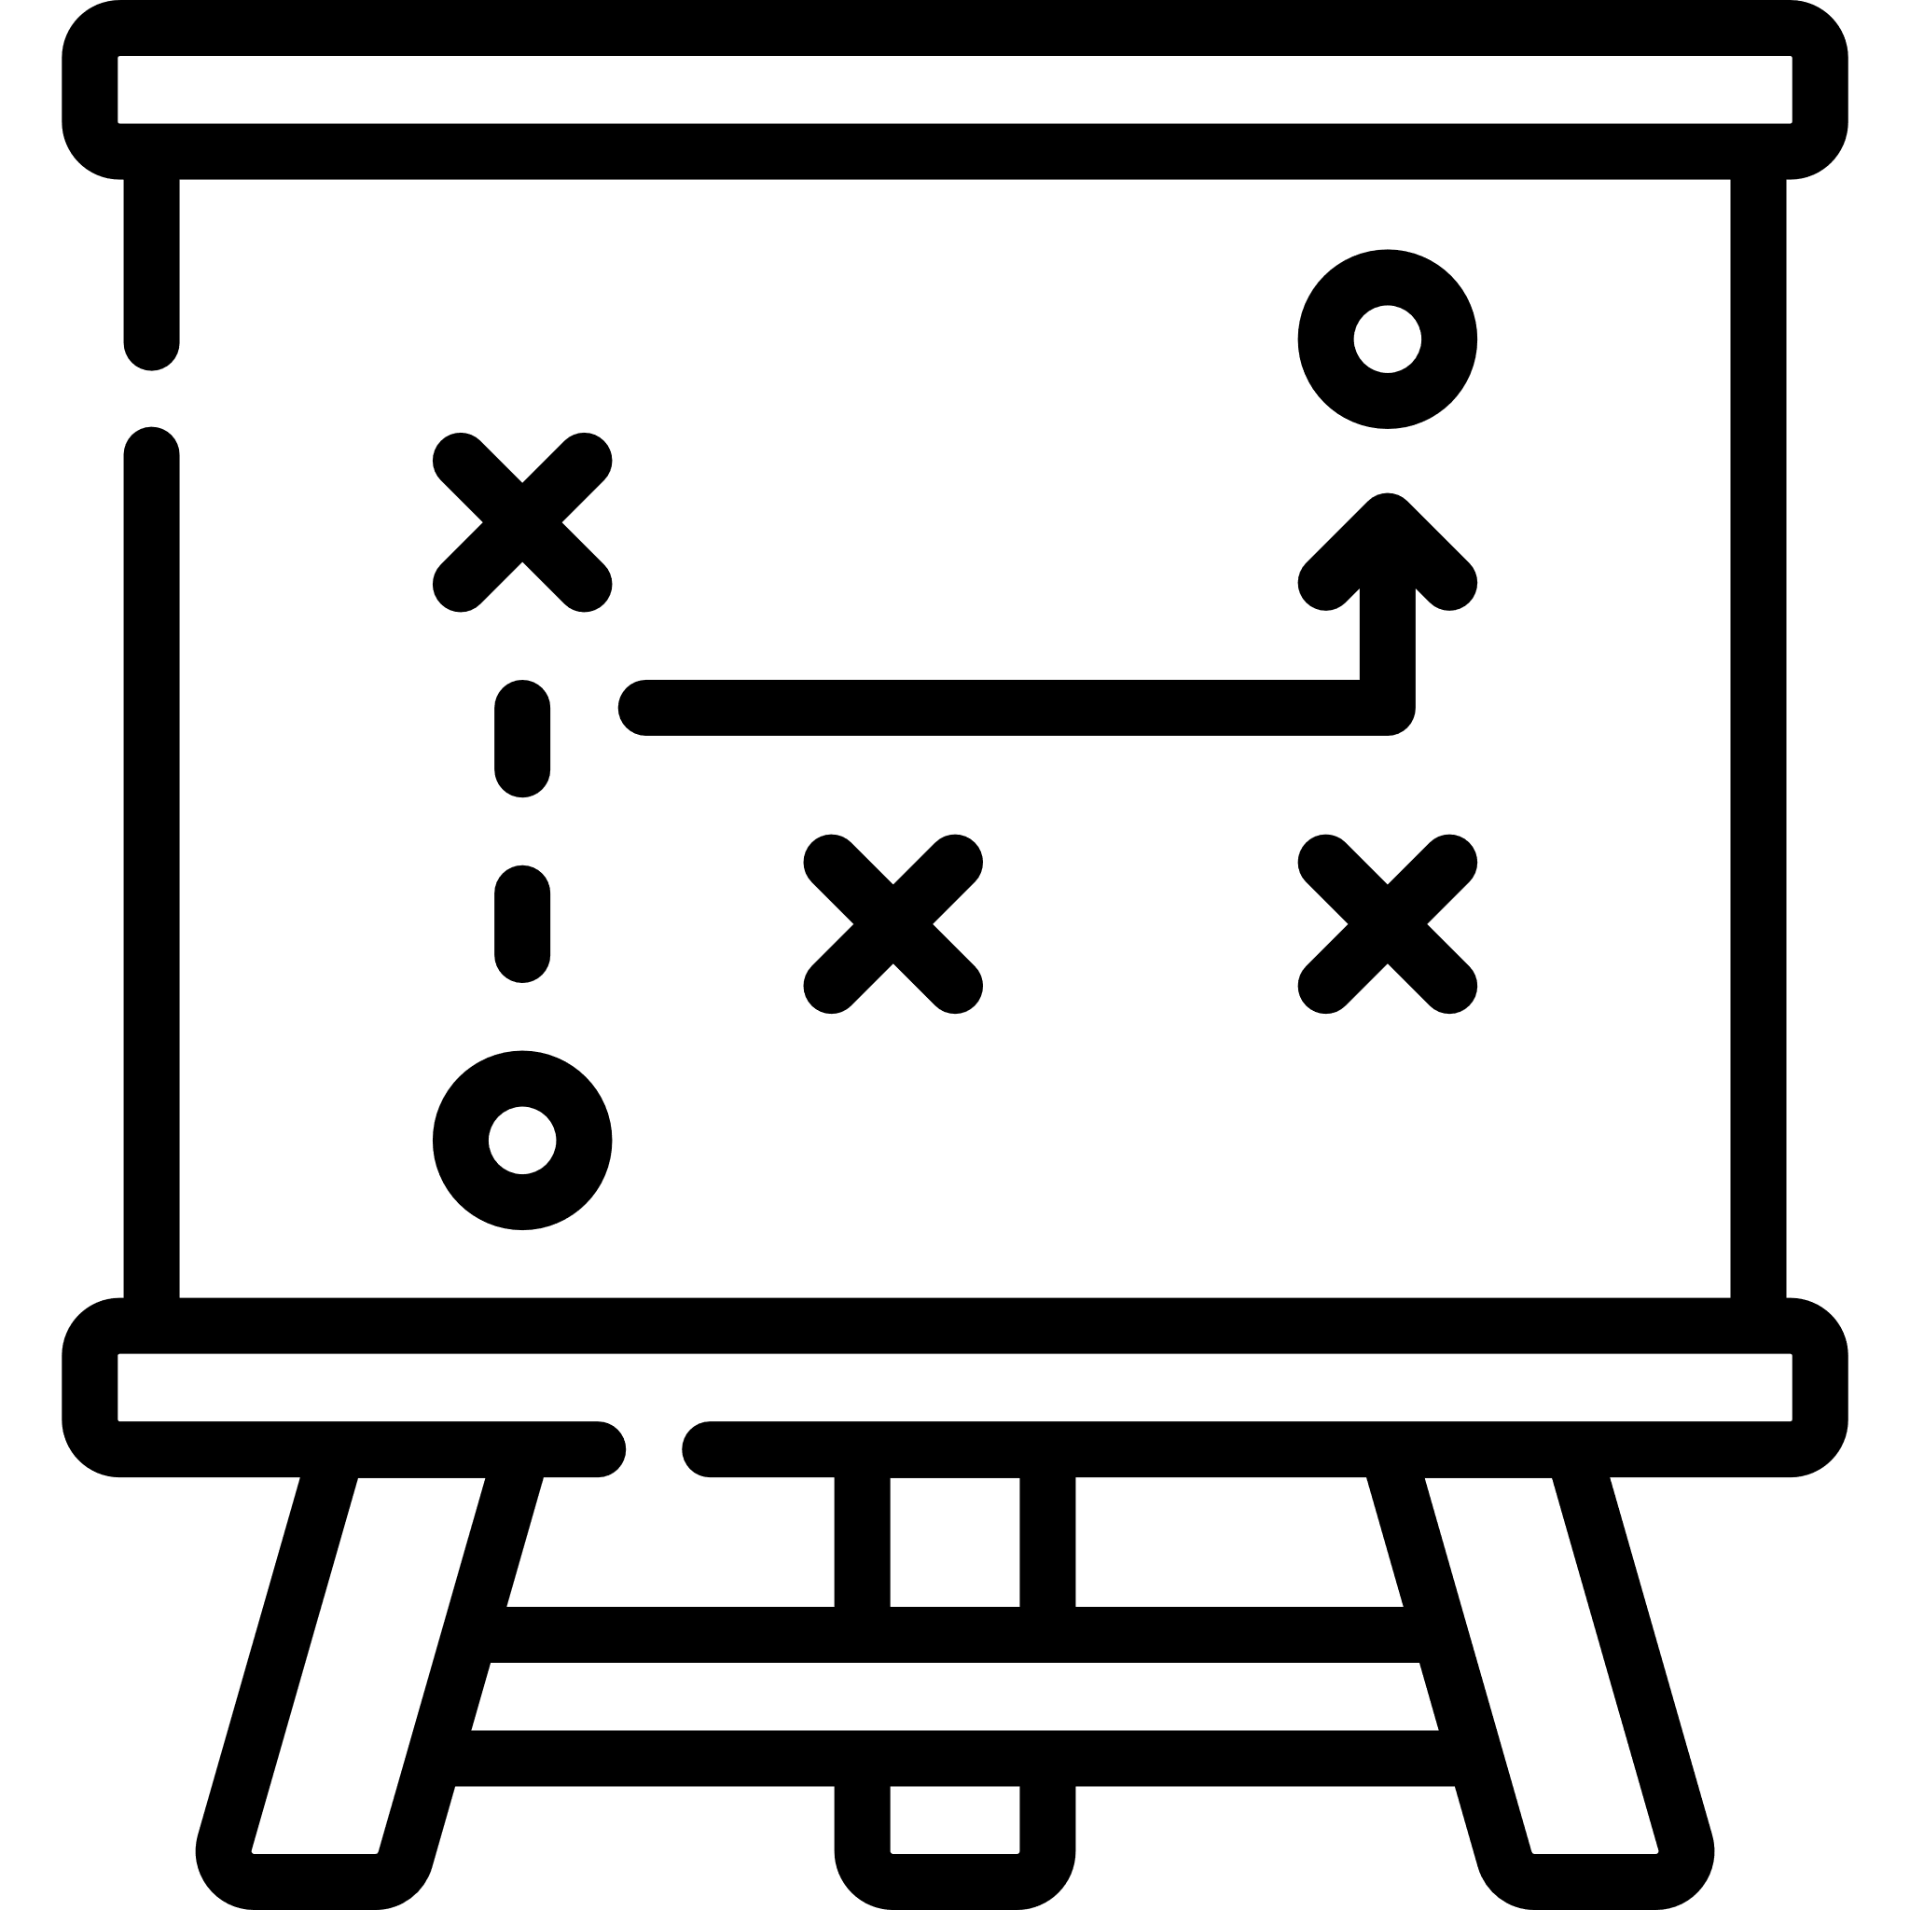





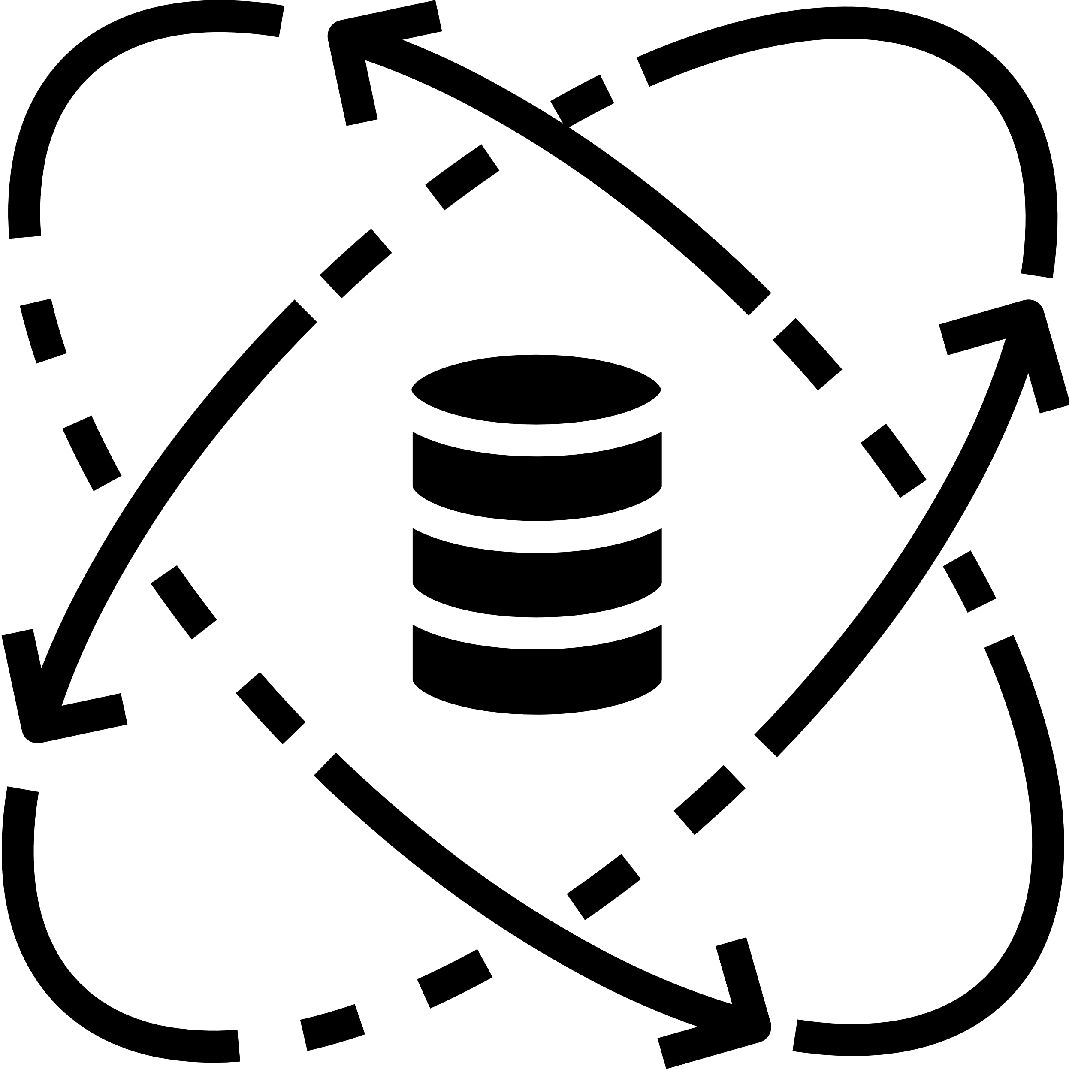

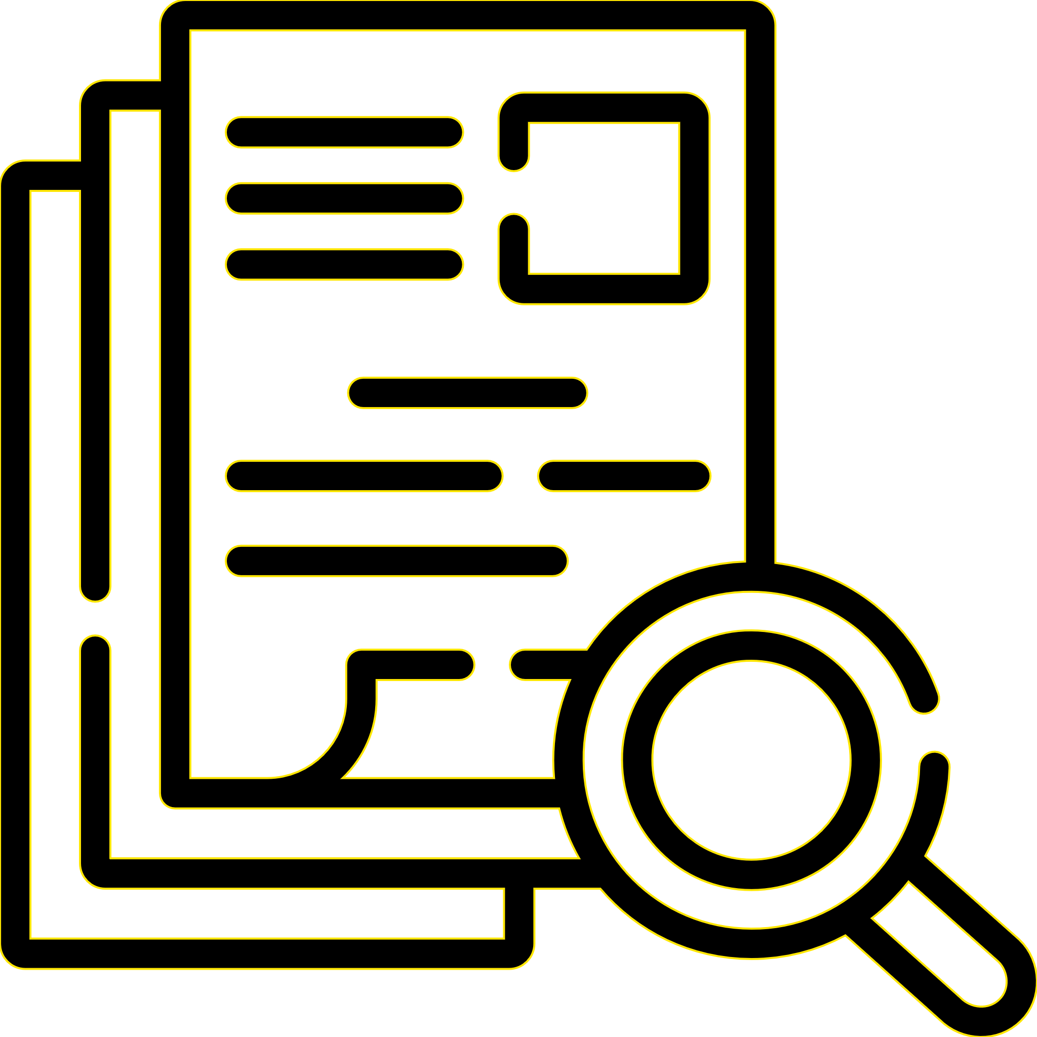
We would like to enable AIAT vision to uplift their capabilities in Technology, Digital and Analytics space through a strategic roadmap
Point of View
Our current focus being the Strategy & Planning, we would like to enable AIA Thailand (AIAT) to embark on the journey deploying new systems, products and features into production.
Phase 1 | Phase 2 | Phase 3 | Phase 4
Strategy and Planning | Platform, Infrastructure detail design, backlog creation & Implementation ramp up | Minimum Viable Product with workloads | Scale & Extend
Metrics Driven | Continuous Value Enablement |  | Delivering Outcomes
XIV. Quick Start 3
XII. Quick Start 1
XVIII. MVP
III. Establish Reference and Target State Architecture
V. Define execution roadmap and implementation plan
VII. Establish environment, data movement and, security requirements / design
XVI. Quick Start 5
X. Initiate Implementation team ramp up
II. Establish integrated
Data Platform Architecture
XIV. Scale beyond quick starts for continued value realization
XIII. Quick Start 2
XV. Quick Start 4
XVII. Measure quick starts and expand demand management framework to elaborate & quality opportunities
IV. Define MVP Based on existing assets and conceptual / logical architecture, prioritized use cases
XI. Initiate execution playbook and related “quick-starts” to measure proof of value
VI. Establish reuse of existing enterprise services and cloud foundations
VIII. Define non-functional requirements and continue design for data storage, storage allocation, and compute allocation
IX. Continue design for domains and key use cases including workload monitor, log monitor, and data assurance
I. Review current state, existing assets & determine viability
Legend:
Current Scope & Focus

Slide 35
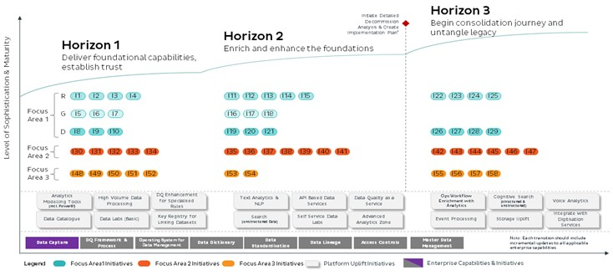
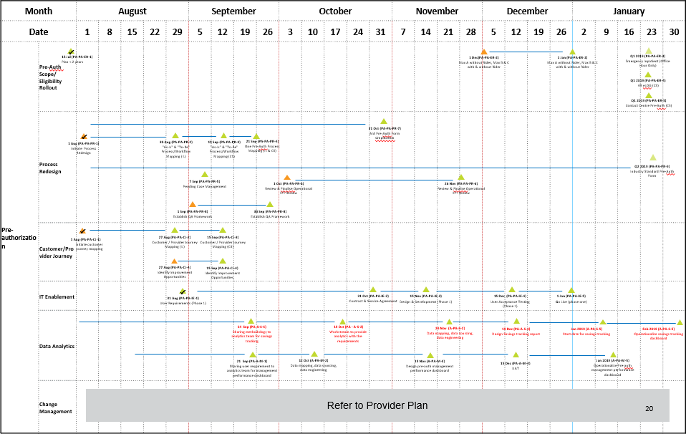
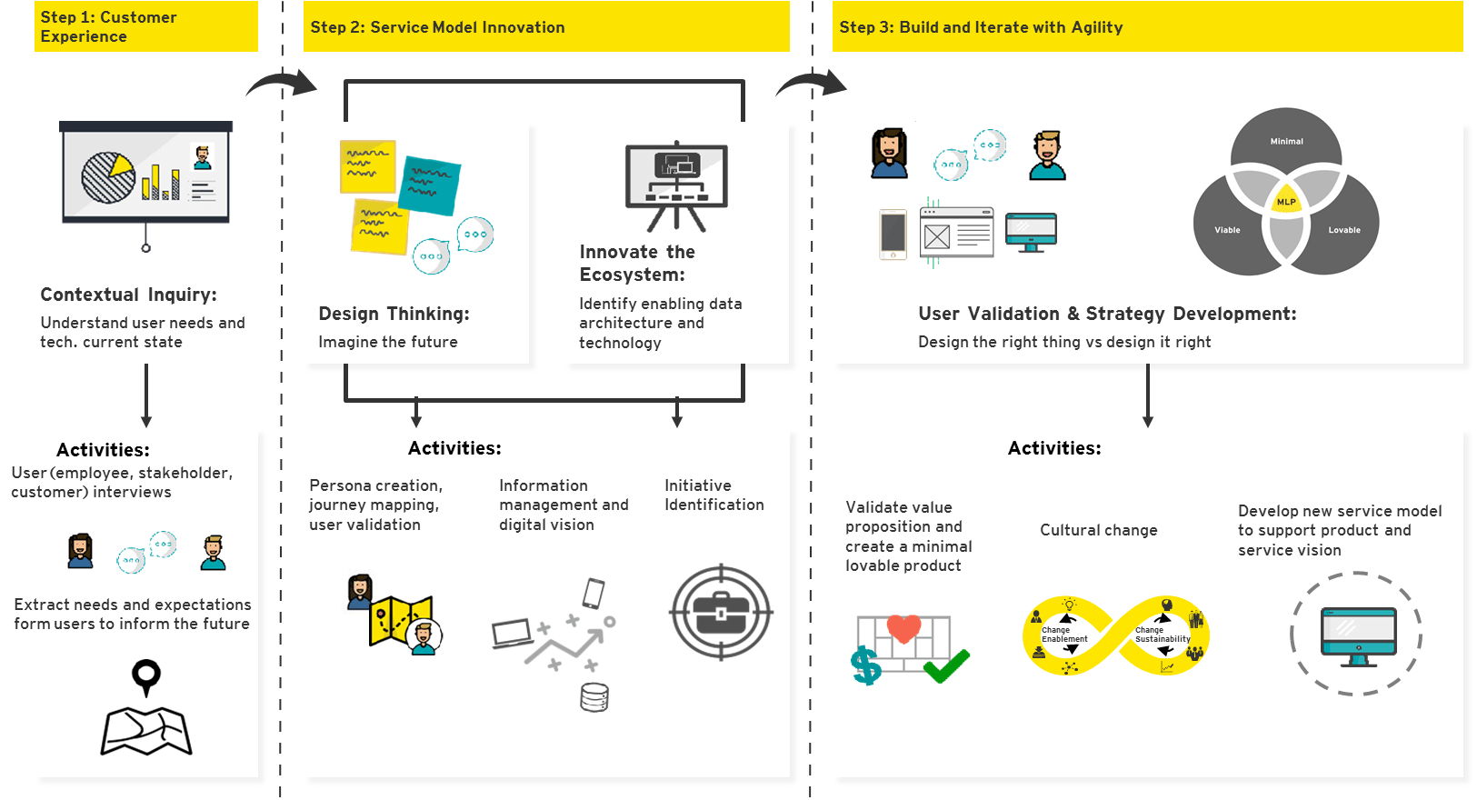
Implementation considerations to include use-cases / initiatives, data platform design and dependency on enterprise capabilities
Approach
Inputs
Process
Outputs
ILLUSTRATIVE
Work Product: IT Strategic Roadmap
Step 1: Receive inputs from the current state findings for platform capabilities
ILLUSTRATIVE
Step 2: Establish & understand data flows for current & target state capabilities and platform standards
Data Platform Capabilities Reference
Step 3: Analyze the Use-case initiatives focusing on details around prioritization and implementation complexities
ILLUSTRATIVE
Step 4: Develop the IT Strategic Roadmap that will have a practical implementation plan accounting for platform build and enterprise dependencies
IT Strategic Roadmap
The roadmap can be broken down into practical implementation plans focused on delivering incremental benefits in alignment with other enterprise initiatives. The timeline, milestones and deliverables for data platform implementation will be clearly indicated in the road map.
Use Cases & Initiatives
Elaboration and Prioritization
EY Accelerator:
EY Data & Analytics Enablers for TOM implementation with Data Ops, ModelOps & Analytics Factory designs
EY Human Centered Design Framework

Slide 36

4
4| Value Added

Slide 37







List of potential use cases to validate our data platform design & architecture*
We will closely work with AIAT stakeholders to confirm on the final use case to be performed for the validation of data platform design and architecture
Single View for Agent
Automated Closed File Review for Health Claims
Create a Single View of Agent to manage and monitor the sales & servicing performance of each Agent
Develop an automated Health Claims solution for our clients leveraging ML/AI capabilities to reduce the time and effort required for a manual closed file review.
Single View for Customer
Customer to Agent Optimization
Create a Single View of Customer across offline/online customer behavior (health, life, pension, AIA vitality, claims, agents, medical providers etc.) that can be used to support Data & Analytics use cases
Use advanced analytics to match the right agent to the right customer based on peer similarity
Digital Microservices
Use the big data platform as a source of data for building new microservice applications
Next Best Offer
Leverage advanced analytics to render the next best offer for a customer via Digital Channels (App, Call Centre, Agent, Web, WeChat/WhatsApp/Line)
Family tree for existing customers
Use Network Graph technology to map and visualize the family tree/householding for existing or new customers
*The pricing for value added activity has not been included in our current pricing and is subject to further discussion with AIAT.

Slide 38



We will deploy an end-to-end Automated Closed File Review for Health Claims leveraging ML/AI capabilities through our Azure Platform Architecture
We have developed an end to end automated Health Claims solution for our clients leveraging ML/AI capabilities to reduce the time and effort required for a manual closed file review. The automated solution is enabled to identify top 5 issue categories and provide explanations for same through a series of business rules. Overall, EY Intelligent Claim Solution provides a single integrated interface for claim management using leading-edge AI technologies and enables
Identification of potential issues and corresponding leakages across claims
Issue root cause identification and validation through business rules and analysis
Solution can also be used as claim management platform which will enable consistency in claims assessment and improved audit procedures across accessors
Key Service Offerings:
Facilitation of CFR leveraging SMEs within the insurers
Creating the Claims master database by consolidating information across multiple data domains including Customer, Claims, Policy, Underwriting, Agents and Provider information
Automated Leakage Issue Category detection using ML/AI capabilities
Root Cause analysis of flagged issues based on business rules and analysis
Financial Impact analysis to quantify total potential leakage
Data Transformation & Real Time scoring of Claims transaction using multi-stage AI models on cloud
EY Hosted end-to-end managed service capability to score claim transactions and flag issues
Financial Institution hosted with EY managed services to score claims real time and flag issues & risks
Offline Scoring of claims data for risk assessment and quick closed file review
EY Intelligent Claim Solution is built on a set of advanced core technologies

Slide 39


AIAT would have the ability to perform Automated Health Claim Assessment while validating our design of Data Platform enabled for deployment of AI/ML use-cases
1
Automated Closed File Review for Health Claims
We would share all the algorithms leveraging ML/AI capabilities, codes and logics that would provide AIA with an ability to perform Automated Health Claim Assessment independently in its Target state Data Platform
2
Validation of end-to-end Azure Cloud enabled Architecture
We would deploy the solution in our Azure Cloud instance of that would also help validate our design and recommendation of the Data Platform Architecture and Capabilities for Target State.
What’s in it for AIAT
Logical Architecture in Azure Cloud
Functional Flow

Slide 40
5
5| Timelines

Slide 41

Agile implementation timeline with iterative sprints to progressively prioritize use-cases and keep enhancing the Data Platform Architecture
Our use cases enablement illustration
The Sprints presented here are an illustration of the sprints that will be undertaken during this project. The exact number of sprints will be finalized with further information
8 Sprints
Sprints 1-3 focuses on assessing the current-state technical capabilities of the data platform, and identifying their gaps within the first 3 weeks.
Sprints 4-8 proceeds to conduct multiple workshops in order to validate use cases and in order to prioritize the various products on offer.
Sprint 9 – 12 is centered around the design and build of the TOM. Each of the four sprints will focus on a separate pillar of framework
4 Sprints
These pillars of framework include the Architecture, Implementation and Roadmap
10 Sprints
Sprint 13 – 22 concerns the Value-add phase, and notably centres around the Implementation of the Health Claim Assessment

Slide 42







We proposed the project timeline of 8 weeks with an agile delivery approach along with value added activities based on use cases selected by AIAT
# | Activity | Week 1 |  | Week 2 | Week 3 | Week 4 | Week 5 | Week 6 | Week 7 | Week 8
1 | Project Mobilization
2 | Data platform capability
3 | Data related- use cases identification and prioritization
4 | High-level Data Platform Architecture Design
5 | Target operating model
6 | Strategic IT Roadmap for Data platform
7 | Value added
Platform Capability Gap Analysis
The first Sprints for both focus on assessing the current-state technical capabilities of the data platform, and identifying the gaps and use cases within the first 3 weeks.
List of use cases prioritised
(8 weeks)
List of use cases identified
Data Architecture design & Implementation Plan
These Sprints are centered around the design and build of the TOM. Each of these sprints will focus on a separate pillar of framework
Completion of the design for TOM
Completion of implementation Plan & Roadmap
The final sprints concerns the value added phase, and notably centers around the Implementation of AIAs selected use cases
Implementation of used case selected by AIAT
A detailed implementation plan for data platform will be developed using Microsoft Project Plan as part of the key milestones for our project. We will work closely with AIAT to manage the issues/risks of the project across the 8 weeks of our project timeline. Any changes impacting the timeline will be subjected to the discussion between AIAT management and EY. The Sprints presented here are an illustration of the sprints that will be undertaken during this project. The exact number of sprints will be finalized with further information

Slide 43
6
6| Our Team Structure

Slide 44












We have a high performing team with full range of expertise to execution in Thai insurance business, data & analytics and digital transformation
AIA Stakeholder
Co-Engagement Partner
Roungkarn Sriprasertsuk Business Consulting Lead EY Thailand
Co-Engagement Partner
Nitin Datta FSO Data Analytic Lead EY Singapore
Subject Matter Advisors (SMAs)
David Chen
Partner
Digital SMA
Regular touchpoints
Chris Barford
Director
Data and Analytics SMA
Overall Delivery Lead & PMO
Pakpoom Thanesuan Associate Director EY Thailand
AIA Primary Contact
Steve Hamill
Director
Data and Analytics SMA
Ongoing project communications
Data Platform Capability Workstream Lead
Arindom Bhattacharjee Senior Data Architect EY Singapore
Data-related Use Case Identification and Prioritization Workstream Lead
Apistha Theerarungsikul Associate Director EY Thailand
Data Platform Architecture Workstream Lead
Mahendra Soni Senior Azure Data Architect EY Singapore
Target Operating Model & IT Strategic Roadmap Workstream Lead
Pakpoom Thanesuan Associate Director EY Thailand
Working team
Sunil Sharma
Data platform capability and architecture support EY Singapore
Attaphon Predaboon
Target Operating Model & IT Strategic Roadmap support EY Thailand
Aaron Lim
DevOps and security support EY Singapore

Slide 45
Project Leadership
Roungkarn Sriprasertsuk
Co - Engagement Partner
EY Thailand, Business Consulting lead
Nitin Datta
Co - Engagement Partner
EY Singapore, FSO Data & Analytics
Pakpoom Thanesuan
Overall Delivery Lead, Target Operating Model & IT Strategic Roadmap Workstream Lead & PMO
EY Thailand, Associate Director
Background
Roungkarn has over 23 years of experience in management consulting, focusing on the banking and insurance industry. She specializes in large scale business transformation programs and system implementation. Roungkarn has led multiple client business transformation initiatives from strategic planning to implementation to operations
Background
Nitin is a Partner with our FSO Data & Analytics in EY Singapore
Nitin has more than 15 years of experience and his core areas of focus are data governance, data usage (BI & Analytics), data architecture & management, data quality and data migration and he has successfully led many analytics engagement for AIA’s business entities across APAC.
Relevant experience
Led health analytics project for AIA Singapore and AIA Thailand based that involved analyzing the existing claims in terms of overall risk, quality and cost benchmarking by looking at family history, claims history, doctors info, agent info, claims forms and supporting documents and coming up with intervention strategies in order to manage their health book and support the foundation of the healthcare transformation
Led the migration of AIA Singapore ’s core applications into Azure and oversight the overall program management and the progress of migration and testing of each application
Led the BI strategy & predictive analytics project for a large life insurance company. The client was facing the twin issues of retention of existing customers as well as dysfunctional information architecture. The client has managed a significant gain 3-5% lift in collections vs. dues in the first month of the roll out and a way forward on the future state information architecture.
Led the build & delivery of micro customer segmentation models, statistical scoring for cross sell and up sell, provided recommendations on integration & interface requirements with channels to assist in marketing analytics campaigns for a large insurer in Singapore.
Background
Pakpoom is an Associate Director in EY Thailand Advisory Practice. He has over 17 years of experience in technology related consultant services, e.g., business and IT assessment, business process improvement, IT audit, IT project management in various industries, e.g., bank, insurance, financial services, telecommunication and manufacturing etc.
Pakpoom has Bachelor of Business Administration in Business Administration (International program) with second class honors, Chulalongkorn University and Master of Science in Business Information Systems, Utah State University, Utah, USA.
Relevant experience
Led data governance assessment and pilot rollout for leading life insurance and Thai Bank.
Led designed DG operating model, policy, standard and procedures including roadmap for implementation
Led data management tool assessment for leading life insurer in Thailand
Led data and process workstream for IFRS 17 implementation for leading life insurance in Thailand
Led gap assessment on target business processes and IT systems comparing with regulatory requirements, leading practices and standard including recommendations for leading financial institutions
Led and performed business process improvement, relevant system implementation and RPA implementation in various companies in Thailand ; project managed business and IT assessment for multiple industries, e.g., manufacturing, insurance, financial institutions, etc.
Relevant experience
Led and designed Data Governance Framework for leading life insurance company and bank in Thailand
Led IFRS 17 implementation for leading life insurance companies in Thailand
Led the strategic transformation and implementation of Operations and IT for leading banks and insurance companies in Thailand​
Led advisory work for insurance regulator in strategic planning, product development, business plan, enterprise risk management/ ORSA, regulatory changed
Led agency transformation and development of service excellence initiatives for a leading Thai life insurer​
Led implementation of Guidewire (GW) Claim Center to improve the speed and efficiency of claims processing for leading MNC Insurer​
Designed and conducted targeted, online consumer research to generate needs-based consumer segmentation using machine learning technology for leading MNC insurer​
Led implementation CRM system to improve sale and services of corporate and retail banking for a leading Thai bank

Slide 46

Subject Matter Advisors (SMAs)
David Chen
Digital SMA
EY Hong Kong, Partner
Chris Barford
Data & Analytics SMA
EY Hong Kong, Director
Steve Hamil
Data & Analytics SMA
EY Hong Kong, Director
Background
David Chen is a Partner in EY’s Advisory Practice, specializing in Performance Improvement IT Advisory. He has over years advisory 17 experience with a focus on complex IT transformation programs. He has an executive MBA, a Master in Information Technology, a Computer Science Degree and a Commerce Degree majoring in Accounting and Finance.
Background
Chris is a Director in EY’s Data and Analytics practice, specializing in in Financial Services. He worked for five years at EY London and moved to EY Hong Kong in 2016. He has over fourteen years financial services consulting experience with a focus on data and analytics. He is typically responsible for end-to-end delivery of complex architectures and platforms, with a functional focus on risk, finance and regulatory analytics.
Relevant experience
Led the creation of the AIA Azure ODS platform, one of AIA’s first cloud based platforms. Developed an Azure based architecture (after an Azure and AWS PoC) and has subsequently continued to expand the platform since 2018. The platform has ingested billions of records and been running constantly ingesting data since 2019. It now supports AIA Vitality as well as related ecosystem items such as App ratings and API ingestion
Led the development of an AIA Group Healthcare reporting solution (Analytica) to allow multinationals to oversee and manage their health costs regionally
Led the data strategy and Azure big data prototype for two financial services regulator. Included data management, data governance and operating model definition for a an open source architecture and five year roadmap
Asian insurer, maturity assessment lead for on-site IT and data delivery capabilities across 13 Asian entities for the regional CIO for two years
Global insurer, digital visualization led a team to prototype and embed a new board level dashboards
Global Universal Bank, Data Transformation as the infrastructure and then business architect in a significant program aimed at radically simplifying their Finance, Risk and Treasury operation
Global Universal Bank, big data strategy developing a design and sourcing approach for big data based risk and finance infrastructure using innovative new technologies
Background
Steve is a Senior Manager in EY Data & Analytics practice in Hong Kong. He is a highly experienced Agile SAFe certified, TOGAF 9, AWS certified Solution Architect specializing in Data & Analytics with 20 years professional experience of Enterprise & Solution Architecture encompassing the whole project lifecycle. Steve has architected solutions for Retail/Business Banking, Higher Education, Retail (FMCG), Government, Institutional Banking, Retail Finance, Private Banking and e-Commerce industries.
Relevant experience
Led the D&A Architecture team and is a highly experienced Agile SAFe certified, TOGAF 9, Hadoop certified, AWS/Azure certified Solution Architect specializing in Data & Analytics with 20+ years professional experience of Enterprise & Solution Architecture encompassing the whole project lifecycle. Steve has architected solutions for the Insurance sector, Retail/Business Banking, Higher Education, Retail (FMCG), Government, Institutional Banking, Retail Finance, Private Banking, Insurance and e-Commerce industries.
Lead Architect to design the Data Foundation platform. The platform was intended to support the Digital transformation of their business and provide a new Advanced Analytics capability for the insurer. The solution was built using streaming technologies such as Apache Kafka and NIFI which extracted data from source systems and landed them into an Enterprise Data Lake. The Data Lake was used to provide the data for Microservice applications and as a source of data for Advanced Analytics using the DOMINO data science SaaS service.
Engaged as the Solution Architect for a Global Institutional Banking MDM project which sought to achieve a single customer view of data across the bank. This involved Architecting an end-to-end MDM Solution integrating 15 source systems in real-time using IBM’s Infosphere MDM Server v9.0 coupled with Information Server 8.1 for ETL, IBM Qualitystage for business rules and customer matching and service integration using IFW via MQ Series.
Relevant experience
Adviser to the APAC CIO on IT governance setup for a large claims transformation program and the setup of IT operational governance framework for a key local country
Program manager for a mobile point-of-sales solution rollout for bancassurance Partner and Agents
Program manager for a new Incentive Compensation Solution that improved agent onboarding process, agent training and compensation calculation
Mobilization lead for a claims transformation program which looked at driving down claims loss ratio, improve operational efficiency and reduce time to roll out products
Service manager responsible for setting up an offshore delivery center to support application maintenance of 20+ applications driving major consolidation and cost reductions
Delivery lead of a core banking platform in China for a major bank. This bank wanted to capitalize on growth opportunities in China and David helped deliver end to end a core banking platform.
Delivery lead of an internet banking platform for this major bank. Responsible as overall solution architect (application, security, integration, data) and in managing the various technology teams across front end, middleware and backend in delivery
Account lead on transformation program which David assisted the bank in delivering a core banking and CRM platform to various countries in the APAC region including HK, Singapore, and India

Slide 47
Project Team Member
Arindom Bhattacharjee
Data Platform Capability Workstream Lead
EY Singapore, Senior Data Architect
Apistha Theerarungsikul
Data-related Use Case Identification and Prioritization Workstream Lead
EY Thailand, Associate Director
Mahendra Soni
Data Platform Architecture Workstream Lead
EY Singapore, Senior Azure Data Architect
Background
Arindom has 12+ years of experience in managing, designing, development, implementation and delivery of enterprise solutions and large scale distributed Hadoop systems.
He has played key roles like Technical Project Manager & Data Engineering Lead and worked across various areas such as technical solution designing, development and deployment of multiple projects that range from enterprise level Data Lake creation to various use case specific Data Marts for leading international banking and insurance clients.
Prior to Big Data technologies, Arindom was associated with various large scale projects in the financial domain like Core Banking, Wealth Management, Corporate & Institutional banking and CRM.
Background
Apistha is an associate director in EY Business Advisory Practice, specializing in insurance
She has over 16 years with industry and consulting experience focus on underwriting, claim, policy owner services, sale & distribution, premium billing , collection, accounting and group insurance for life insurance and non life insurance
Her experience range from business analyst, process improvement, e business , system implementation, project management and change Management
Relevant experience
Led the use case identification and prioritization workstream to identify the use cases of data governance implementation for a leading insurer in Thailand
Supported the establishment of framework, operating model and roadmap for the health transformation programme for AIA Thailand
Led the closed file review for AIA health claim to identify potential leakages caused by excessive length of stay, unnecessary medical treatment, fraud, etc. and recommend initiatives to overcome such leakages
Developed business and functional requirements of group insurance module on core insurance system for leading life insurer in Thailand
Designed functional requirements for e business portal such as privilege customer and agent website for leading multinational life insurer
Led business analyst , system design and system testing for Policy Servicing Area for Multi-currency Unit linked product for leading multinational life insurer in Japan
Led business team to develop test script and plan for core insurance system for leading life insurer in Thailand
Implement the data warehouse, MIS and Dashboard system for regional office of multinational insurance company
Experienced in dealing with management and lead business units in number of implementation projects
Background
Mahendra is a Data & Cloud Architect in EY’s Technology Consulting Practice and he has 14+ years of consulting experience.
He has lead multiple projects on Cloud Migration (Azure and AWS), Data Integration, Data migration and Data Management & Big Data Analytics.
He has worked with multiple clients in Banking & Finance, Government & Public sector, Port & Shipping, Education, Agri Business, Retail & Life Sciences domains.
Relevant experience
Led migration program for core applications of AIA Singapore to Azure and oversee the project management, current state assessment for each application, target state design and migration including deployment and cutover and overall quality and testing management, which included infrastructure, functional, data and performance testing
Led the cloud migration (on Microsoft Azure) for enterprise applications for leading agri-business client
Led the end to end design of IFRS17 data mart solution for leading Insurance client on Microsoft Azure
Led the cloud migration for a compliance reporting on cloud (AWS) for leading Bank in Singapore
Led the a data migration project for a leading Financial Institution (in Singapore and revamped their management reporting from traditional technology stack to self service management reporting on Big Data (Hortonworks)
Led the data ingestion project on Big Data Platform for leading insurance client in Singapore
Led the data migration project for a Government agency in Singapore
Relevant experience
Led the migration of data analytics platform from on-premise to cloud (Azure) as a part of digital transformation initiative for a global PE firm
Designed and built a flexible data ingestion system on AWS cloud platform to ingest, cleanse & transform a variety of data formats like structured, semi-structured and unstructured to augment a data science project for a global investment firm
Implemented data lake migration from Teradata platform to Hadoop platform for a leading international bank
Led the data engineering team who designed and implemented scalable system to ingest and process very large amounts of data (structured and unstructured) into an enterprise level data lake
Led the Data Engineering team for IFRS17 data ingestion project into Hadoop Data Lake from disparate source systems using Oracle and DB2 databases
Designed and developed a Data Quality Assessment system with SAS Viya & SAS Visual Analytics dashboard, which provided both high-level and detailed view on the quality of data across using Propensity to Buy Machine Learning Model for a leading Insurance firm in Asia

Slide 48
Project Team Member
Sunil Sharma
Senior Data Engineer
EY Singapore, FSO Data & Analytics
Attaphon Predaboon
Target Operating Model & IT Strategic Roadmap support
EY Thailand, Data & Analytics
Aaron Lim
DevOps and security support
EY Singapore, DevOps Engineer
Background
Sunil is a Manager in EY’s Data & Analytics Practice, focusing on Bank & Financial Services. He has 12+ years of technology experience with a focus on data warehousing, data analytics and data governance engagements.
Relevant experience
Implemented of MAS 610 regulatory reporting for a regional bank in Singapore. Worked on requirements gathering, identification of the data gaps, built dimensional data model for the underly data mart as per the Vermeg data requirements, designed the data quality framework and ETL design to be implemented on AWS Cloud
Worked as Technical Consultant for major Insurance companies in APAC region to meet their IFRS 17 requirements. His role in these assignments include gathering the data requirements of IFRS 17 solutions (Aptitude, SAS) & Prophet, building data models and building data mart on big data platform using enterprise ETL tool (Talend, SSIS) to meet the IFRS 17 data requirements. Defined data governance & quality guidelines as agreed with client
Worked on implementing the data governance and data quality standards as a part of CRM data migration project for a key financial agency of Singapore Government. Helped the organization by providing Data classification recommendations to ensure EU’s GDPR and Singapore’s PDPA compliance, performed data discovery exercise on key tables to categorize the data in based on its confidentiality levels; and helped them define of data governance rules and metadata
Worked with a leading Insurance company in Indonesia to develop analytics dashboard for their financial data using Power BI. This helped the business users to have more valuable insights of their data
Performed data quality analysis and delivered a data quality dashboard on customers’ data of a leading Insurance company in Singapore. This helped the business to understand the value of the existing data and also how to enhance & improve it. Performed assessment of existing data governance framework and helped them improve and define the data standards, data control rules and data extraction processes
Background
Attaphon is a Manager in EY’s IT Advisory​ . He as 6 years of experience in a multinational corporation and consulting firm with a history of working in Oil & Gas, Manufacturing and Beverage industries in Bangkok and overseas (e.g. USA, Korea, China, Cambodia) ​
Attaphon has hands-on experience in data lake design and implementation, data warehouse migration, value chain data analytics in his professional and educational background​
Relevant experience
Data Warehouse Proof of Concept, Design and Development​
Proof of Concept SAP HANA 2.0 on XSA architecture, define ETL technology recommendation and setup up the corporate data lake platform on SAP HANA XSA integrated with SAP BW and MSSQL​
Develop high-level recommendation of data governance and data management process​
Design and implement SAP BW financial report and data model based on COPA and PCA data sources, enhance complex financial consolidation application using on ABAP routine, for SoPAC and North Asia countries of the MNC Oil & Gas company ​
Design and implement logistics optimization model based on standard 2LIS and various customized extractors to determine optimal transportation mode, and optimize truckload utilization​
Manage application support team for overseas stakeholders. Perform technical review of the data model developed by offshore team​
Background
Aaron specialises in front-end development, UX designs, agile methodologies, DevOps and data analytics.
He is experience in DevOps offers in-depth understanding of software development and information-technology operations within the SDLC.
Relevant experience
Experienced working in agile scrum project leveraging software development management tools such as Jira, Confluence and BitBucket
Performed current state assessments on DevOps technology tool stack and recommended target state initiatives and new SDLC governance controls for one of the largest large local Bank in Singapore
Lead and establish a CI/CD transformation program at a global insurance company in Singapore to adopt new ways of working. The program encompass a new target operating model for CI/CD and establishing an end-to-end CI/CD pipeline
Worked with an insurance company in Thailand to build a dashboard that assist in the visualization of data retrieved from the Hybrid Deep Learning Model to better allow management to identify possibly misused of insurance benefits and derive segments in which there is most risky customers
Worked with a multinational insurance company in Singapore to redesign their user journey for agents to manage clients and for customers to track their existing policies. This included designing and building a prototype insurance application for customers and agents
Designed and build a prototype DevOps dashboard for one of the largest large local Bank in Singapore
Worked with a large multinational bank in Singapore to build a culture and conduct dashboard that monitors the bank’s internal conduct risk environment
Conducted Agile and DevOps workshops for multiple banks and insurance company in Singapore, Malaysia and Thailand

Slide 49
7
7| Our Credentials

Slide 50


Case Study 1: Enterprise Data Warehouse Migration and Cloud Based Data and Analytics Platform for AIA HK
Challenge
In line with the group’s broader Group Cloud strategy, AIA HK team was seeking to migrate their current on-premise data warehouse to an on cloud solution.
The existing on-premise solution was made up of multiple disparate data sources with hundreds of source system tables which fed downstream applications used for operational business and reporting purposes.
The main challenge faced by the client was to securely migrate all data onto the new platform on Azure within 18 months in order to minimize the time required to run two systems concurrently.
How EY Helped
Conducted a modernization assessment to understand the as-is architecture, integration interdependencies, risk and compliance/regulatory factors, business criticality and business use of the application.
The application modernization assessment produced a target state Azure based Enterprise Data Platform architecture that was used to build and migrate the existing platform architecture within 12 weeks. EY cloud migration accelerators were used to expedite the migration of the base tables.
Informatica BDM was used to transform thousands of lines of PL/SQL from multiple source systems into a Data Lake built using Azure blob storage
Azure Blob Storage Data Lake was used to feed an MS SQL database which integrated data from multiple source systems into a single view of customer database which was used to feed Dynamics 365
DevOps and DevSecOps pipelines were built to facilitate CI:CD and secure code assessment
A reusable secure Cloud Data Tokenization framework was developed to tokenize PII and PCI-DSS data
Azure Key Vault was used for storage of shared secrets and system credentials
Results at a glance
Development of a fully modernized secure cloud data platform within 12 weeks which enabled early demonstration of the value of the platform investment and ability to execute the full migration within target timeframes.
Alignment to the group’s ‘cloud first’ strategy with the use of Azure to host the analytics platform
Delivery of a DevOps and Secure DevOps framework to allow fast releases and secure code assessment
Delivery of cloud data migration accelerators using Informatica BDM dynamic mapping framework that allowed for fast migration of large amounts of data at scale
Notes:
Received from Steve Hamill - AIA_References.pptx

Slide 51


Case Study 2: Migration of application systems from on-premise servers to Azure cloud for AIA SG
Challenge
In line with the group’s broader Group Cloud strategy, AIA SG team started their cloud transformation journey more than a year ago. The cloud migration program has been planned in 3 phases which involves migrating 140 applications, including system modules & components, from on-premise to Azure cloud.
Phase 2 Cloud migration was achieved through 3 simultaneous workstreams – Project Management Office (PMO), Application Migration Services and Quality & Test Management service
The main challenge faced by the client was to migrate both legacy applications securely onto the new platform on Azure within 9 months while ensuring no loss in their performance and functionality vis-à-vis on-premise standards
How EY Helped
Conducted a discovery assessment to understand the as-is network architecture, upstream and downstream dependencies, data & file structure, business criticality and business use of the application.
Designed target state patterns that addressed both legacy systems in an effective and future-proof way while maintaining performance and functionality standards as seen on-premise
Created an agile migration timeline across the span of 6 months
Both applications were broken down into modules to be migrated in each sprint
Modules were grouped based on its interdependencies and logical similarities
Migrated both applications into 4 environments – SIT, UAT 1, UAT 2 & Prod across the span of 6 months
Tested the performance and functionality of both applications and ensured both systems performed equal or better than on-premise
Provided warranty support to resolve any operational issues for the in-scope applications migrated to cloud
Results at a glance
Development of 3 timelines – high level, low level and sprint timeline which enabled early communication of the overall migration progress to key stakeholders
Development of a migration playbook which consists of the migration approach, blueprint, pre- and post-migration checklist and mapping to cloud resources and groups to ensure smooth migration within the target timeframe
Delivery of both legacy applications onto Azure cloud using agile methodology fully utilizing agile artefacts and ceremonies to ensure quick response to key risks & issues
Conducted performance and functional tests within sprints which enabled early response to errors and mitigated cutover risk
Provided 3 months of warranty support to ensure all operational issues were resolved
Notes:
Received from Steve Hamill - AIA_References.pptx

Slide 52



Case Study 3: Built the Cloud Strategy & Cloud Centre of Excellence for AIA Group
Challenge
In alignment with AIA’s broader infrastructure strategy to reduce its on-premises data center footprint, AIA required a Cloud Strategy to help drive cloud adoption and set the guardrails for applications seeking to migrate workload to Cloud
To be successful in Cloud adoption, AIA identified the need for a Cloud Centre of Excellence(CCoE). The CCoE would be the accountable business unit for cloud governance oversight and would be established with specific skills & objectives to be instilled in relevant end users
How EY Helped
EY defined the Cloud Strategy in line with AIA’s Propel Business Strategy
The following activities were undertaken as part of the Strategy formulation:
Assessment of AIA’s current state technology environment to determine maturity and application readiness
Develop cloud technology vision and high-level delivery models that are tailored to AIA's strategy
Defined the Cloud Adoption Approach, Cloud Services Catalog, Cloud Suitability and Migration framework and Guiding Principles for Cloud-Native Applications
Below activities were taken as part of the Cloud Centre of Excellence (CCoE) formulation
Defined the roles & responsibilities required to staff a CCoE
Built the Cloud Governance model which included the decision-rights and accountability framework for adoption and sustenance of cloud services in AIA.
Designed the CCoE Operating Framework which was structured into 3 horizontal functional areas (People, Billing, Security & Control) to mitigate the enterprise risks associated with Cloud adoption
Setup the CCoE process maps for Incident, Problem, Change, Provisioning, Patching, Images and billing to support the CCoE run model
Defined the service catalog & request process to request IaaS & PaaS based Azure services in an automated manner
Defined the Cloud orchestration, cloud tagging & billing processes and procedures
Results at a glance
The Cloud Strategy set the guardrails and boundaries for cloud adoption across AIA Group and its business units and provided an underpinning strategy that enabled AIA to migrate 500 apps to Azure
The Cloud Centre of Excellence was established and is providing governance, provisioning, billing, management & support to applications seeking to migrate workload to cloud & also supporting those applications that are built using cloud-native services
Notes:
Received from Steve Hamill - AIA_References_cloud_modernization.pptx

Slide 53



Case Study 4: AIA Corporate Healthcare (Analytica)
Challenge
AIA Group provides an optional subscription based self-service reporting capability to corporates called ‘Analytica’ that enables them to report on the health of their employees as part of the corporate health insurance
The existing solution integrated data from multiple APAC countries , where each set of reports served via Analytica provided required a separate set of integrated data and a set of custom dashboards
The Reports allowed corporates to analyze the types of claims, the hospitals/doctors providing the services and the cost of those claims in comparison to the cost of the policy, but HR department within multi-national corporates had no regional view of this information and struggled to consolidate this information into a cohesive dataset
Rendering of the Reports via the user interface was taking up to 30seconds resulting in a poor user experience and adoption by multi-nationals. The existing Analytica solution was not scalable or portable to Cloud
How EY Helped
EY conducted an assessment of the Architecture and recommended that AIA engage EY DnA to re-write the solution to address the usability and performance concerns
EY defined a new Target Architecture for the solution encompassing a newly modelled Operational Data Store and Data Warehouse with ETL integrating data from multiple countries into a single data set. This was built using SSIS on a SQL Server MPP database. The Architecture was designed to be portable to Public Cloud
To solve for the Reporting issues, EY designed a set of tool agnostic wireframes that could be built on any visualization tool. The wireframes provided a templated approach to reporting that would facilitate deployment to multi-nationals and local companies. The wireframes were implemented on AIA’s existing tooling SAS Visual Analytics and exposed to end users through a web based portal
Fine grained access control was implemented at row level to ensure that corporate data from separate countries was isolated. HR was provided with a regional view of ALL data to facilitate Asia Pacific regional reporting
EY also wrote an independent BI tooling assessment that assessed AIA’s future state requirements against market leading BI tools. The report will be used to inform AIA’s future reporting & visualization direction for Analytica
Results at a glance
AIA Group Health saw significant performance improvements on report rendering from 30seconds to 3 seconds
The development of a single Operational Data Store and DataMart has reduced the support and maintenance costs significantly
Analytica is now scheduled to be rolled out to a further 18 countries with the new wireframes and dashboards providing a more modern user interface coupled with enhanced usability and the new solution was built within 8 weeks in comparison to the original development of Analytica which took 2 years to build and deploy
Notes:
Received from Steve Hamill - AIA_References.pptx

Slide 54



Case Study 5: AIA Vitality Analytics for AIA Group
Challenge
AIA Vitality is a science-backed wellness program that works with customers to support them to make real changes to their health. The rollout of Vitality to 11 countries resulted in a massive increase of data provided by customers to AIA. Vitality data could be used to better service customers and develop new product propositions to meet changing customer demands
Due to the success of Vitality, there was an increasing demand from business users for timely and better access to Vitality data and tools for self-service analytics
How EY Helped
EY defined a new Target Architecture for Vitality Analytica encompassing data sourcing from 11 countries into newly modelled Operational Data Store and Data Warehouse
Azure Data Factory was used to integrate data from multiple countries into a Data Lake built using Azure blob storage
The Data Lake was designed for portability to Azure Data Lake and was used to feed the data marts on Azure SQL Warehouse
The Datamart was overlaid with a series of Tableau dashboards and reports that were served across multiple countries.
An Analytics workbench was developed on Azure using VMs pre-built with IDE tooling and libraries such as Jupyter, Anaconda and R. This was built on Azure using SSIS on a SQL Server MPP database. The Architecture was designed to be portable to Public Cloud. This enabled Data Scientists to execute machine learning models that integrated Vitality data with policy, claims and premium data to identify and detect fraudulent claims across the AIA Group
To ensure success, EY developed an Analytics Target Operating model for Analytics to support Vitality and the wider AIA Analytics teams
Results at a glance
Integration of once siloed data to facilitate advanced analytics on IOT/Vitality data deployed onto Azure
Alignment with AIA’s ‘cloud first’ strategy with the use of Azure to host the analytics platform
Deployment of consistent tooling to support analytics and new ways of working across the region
Implementation of an Analytics Target Operating model resulting in the appointment of a Chief Data Officer to drive analytics adoption across the wider AIA Group

Slide 55



Case Study 6: Global Data and Analytics platform design and implementation for large global insurers in APAC
Challenge
The client has engaged EY’s Data and Analytics team to design and implement a cloud-based Global Data and Analytics Platform (GDAP) to enable scalable and consistent analytics operations to each of its 5 regional divisions – Australia/NZ, North America, Europe, Asia-Pacific and Group.
Analytics teams have expressed a need for a standard platform that enables data acquisition, provides consistent tools for the model development life cycle and streamlines deployment of insights
The proposed cloud platform was required to solve critical challenges such as long analytics model development and deployment cycles, fragmented data, lack of consistent tools, difficulty in collaboration and exposed risk due to limited security controls in the current environments
How EY Helped
EY designed and implemented the platform using a template based Reference Architecture for cloud based analytics platforms
The architecture embeds security by design, with the solution implementing controls and tools to encrypt, audit and monitor data in motion and at rest, as well as integrated user-access management
The Client’s legal, compliance and risk teams were engaged early in the design phase to ensure platform compliance with divisional specific regulators and jurisdictions
Analytics and Actuarial teams were engaged throughout the implementation to incorporate user perspectives and requirements. A business enablement stream was responsible for user training, user acceptance training and user adoption – as well as the co-ordination of the global rollout
EY leveraged strong resources from its Project Management competency to ensure successful and timely delivery
A managed services team was deployed to support the platform during BAU
Insert picture/slide screenshot here
Results at a glance
EY enabled industry leading data and analytics capabilities to support the analytics teams to deliver on client’s strategic agenda:
Globally deployed a global data and analytics platform on Azure enabling a consistent and scalable collaborative analytics environment, including self-service capabilities
Accelerated business value from reduced cycle times for analytics model development
Accessible data with improved quality and coverage within divisions enabling the focus on analytic insights/delivery
New analytics ways of working, streamlined collaboration and best practice sharing between divisional spokes and hub
Improved information security and data controls to ensure data access and privacy, as well as regional compliance across all divisions

Slide 56


Case Study 7: Data and Analytics Platform and Migration to Azure for Fuel and Retail Provider in APAC
Challenge
The client has engaged EY’s Data and Analytics team to review their data and reporting capabilities
Together with the CIO and his business partners across Finance, Supply Chain and Marketing EY identified challenges in the data and reporting landscape and created a roadmap to improve data and analytics capabilities.
EY continued the engagement with a business data acquisition stream as well as a platform stream to design and implement a cloud-based Data and Analytics Platform.
This included a migration from the existing platform to the strategic hosting platform on Azure and on-boarding 300+ data sources through an EY developed data quality enabled Ingestion Framework.
How EY Helped
Conducted prioritisation sessions with CFO, CIO and group executives to define critical areas capability uplifts
Designed and implemented the platform using a template based Reference Architecture for cloud based analytics platforms, Microsoft supported with architectural and cloud guidance and migration approach
Led the redesign of the infrastructure and security architecture with support from Microsoft and partners
Leverages Azure as a hosting platform for the architecture, with HDFS as a data layer and DC/OS as a container analytics environment supporting the end 2 end analytics lifecycle
The Client’s security, infrastructure and enterprise architects were engaged early and often in all phases to ensure platform compliance and embedding security controls
A data acquisition stream was responsible for on-boarding the right data tagging meta data to automate the ingestion and cataloguing of data elements.
Results at a glance
EY enabled scalable, templated data and analytics capabilities automating ingestion with meta data cataloguing and a new operation model to deliver to the client’s strategic agenda.
Enabled IT to champion the importance of consistent data platforms, data governance and business ownership of data using practical and efficient processes
Core platform capabilities like Hadoop data layer, data ingestion, data quality validation, meta data catalogue and extension to business glossary. Self-service data ingestion mechanism and governance. Big data platform integration with enterprise data warehouse.
Azure templates for scalability and simplified maintenance
Container analytics environment for accelerated analytics model development and deployment
Migration of data and applications from the legacy cloud environment to Azure

Slide 57



Case Study 8: Architected, Designed and Implemented Cloud Native Big Data Regulatory Platform for a large Wealth & Asset Manager
Challenge
A large financial services company needed the ability to easily retrieve trade lifecycle information for US Equities and Fixed Income for regulatory, supervisory and analytical purposes
Operations support, regulators and analytical data scientists needed:
A single golden source of trade information
Information about complete lifecycle: orders, fill, trades, prices, quantities, times, routes, cancels, splits, etc.
Respond to FINRA regulatory inquiries - Consolidated Audit Trail (CAT) and Electronic Blue Sheets (EBS)
How EY Helped
Established overall requirements for the private cloud regulatory platform linking Clients, Accounts, Orders, Fills, Trades (CAT, EBS, OATS)
Established the detailed architecture, design and data models for the creation of the private cloud Big Data Regulatory platform / data hub
Established the cloud native technical stack, open source components, and cloud based agile pipeline architecture (ingestion, integration, events and data marts) for various zones along with a detailed DevOps migration and implementation plan
Established the data catalog and ELDM (logical model) for information related to clients, accounts, orders, routes, fills, trades from internal order management systems, external vendors (Fidessa, Brass/Valdi, ACT, ORF, etc.) and OATS (Order Audit Trail Systems)
Developed, Implemented and Released the full end to end private cloud big data platform CAT supervisory and EBS platform using:
Cloud native modules based on Cloudera Data Platform, Apache HDFS (Hadoop), Apache Hive, Apache Impala, Apache NiFi, Apache Spark, Python, PySpark, Tableau, YARN, MS VSCode, Luigi, Autosys, Git and agile DevOps
Provided a consolidated set of trade lifecycle events linking clients, accounts, orders, routes, fills, trades across the various systems
Purpose built data marts for interactive and batch queries in the BI reporting layer in the private cloud to be ported to Azure
Results at a glance
EY architected, designed and implemented a modern data warehouse - cloud native Big Data regulatory platform:
Cloud native solution architecture and end to end implementation
Custom built open source private cloud Regulatory Big Data platform for trade lifecycle events and linkages with clients and accounts
Agile Data Lake/Hub pipeline including: ingestion, Integrated data layer, Purpose built data marts for BI reporting and regulatory inquiries and supervisory functions in private cloud
Unified single source of truth for AI and data scientists to leverage lake, finance and analytics domain

Slide 58



Case Study 9: Accelerate multi-cloud adoption to leading international investment bank
Challenge
While looking to accelerate multi-cloud adoption, this investment bank was looking to solve the following key management challenges:
Meet business requirements that required encryption keys and data be managed by separate entities
Meet key management requirements for key expiration, rotation and management environment security
Allow reuse of key management infrastructure for cloud service provider managed key management services as well as third-party standalone cloud services
Protection for stored keys using a certified, tamper-resistant hardware device and full tamper-proof audit log
How EY Helped
Defined an execution roadmap based on business requirements for addressing the firm’s immediate hybrid cloud capability needs as well as provides for long term scalability to multi-cloud environment
Designed a key management process that accounted for entire key lifecycle: key generation, activation, expiration, post-activation, escrow, and destruction
Architected and deployed the solution for Gemalto SafeNet Hardware Security Modules (HSM) across redundant datacenters
Architected and deployed redundant Gemalto SafeNet KeySecure virtual security appliances integrated with Gemalto HSMs
Conducted a Slack EKM implementation allowing Lazard to bring their own keys (generated on Gemalto HSMs), allowing lot more control and visibility over their sensitive data
Coordinated the client’s Microsoft Dynamics 365 implementation with Customer Managed Key (CMK) on Azure
Designed Box KeySafe integration AWS Key Management Service with Customer Master Key generated on Gemalto HSM
Results at a glance
Digital / Cloud / Next Gen Fintech / Security
Gemalto HSM implementation
KeySecure Secure Appliance implementation
Slack EKM implementation with CMK
Microsoft Dynamics 365 implementation with CMK
Box KeySafe integration with AWS KMS

Slide 59



Case Study 10: Help accelerate multi-cloud adoption for a leading international investment bank using Containers
Challenge
While looking to accelerate multi-cloud adoption, this investment bank was looking for solutions to meet the following requirements:
One standard way to package and one standard orchestration to deploy internal as well as third-party applications on containers
True portability between different cloud service providers like AWS, Azure and GCP as well as on-prem datacenters
Realtime CMDB that support multi-cloud environment and support AWS and Azure
How EY Helped
Architected and deployed enterprise grade Azure Kubernetes Service (AKS) , accounting for cluster auto scaling, horizontal pod autoscaling, network connectivity, monitoring as well as hardening environment to meet security standards of customer
Deployed Indico Intelligent Process Automation, a product for creation of AI powered custom models for the analysis, classification and comparison of unstructured content on Azure AKS
Deployed ServiceNow integration with AWS and Azure for cloud discovery, service mapping and integrated service management
Enabled active cost optimization on Azure and AWS by monitoring, baselining and alerting on costs through tagging, deployment polices, reserved instances and daily reporting
Designed and architected Cloudability integration with AWS and Azure cloud subscriptions
EY’s optimizations collectively achieved over 15% cost reduction on Azure resources by actively identifying orphaned disks, right sizing resources, optimizing data transfers, scheduled start-up and shot-down of development environments
Results at a glance
EY architected, designed and deployed a containerized multi cloud using:
Azure Kubernetes Service implementation
Indico IPA deployment on AKS
Tagging Policies for Azure
Cloudability integration with AWS and Azure

Slide 60

Case Study 11: Azure Modernization - Cloud-based omni-channel application for a global banking client
Challenge
The global bank sought to increase customer engagement by offering personalized contextual omni-channel banking experience
Build a cloud-based innovation platform to host an end-to-end AI/ML capability; processing real-time and batch data to generate personalized actions and content
How EY Helped
Established design patterns and architecture principles for the next generation platform
Recommended cutting edge real-time data processing frameworks to enable in-flight data analysis
Leveraged Azure Cloud services to develop an AI/ML execution engine with support for online and batch training
Constructed a fault-tolerant, distributed and elastic platform that scales with demand
Built micro services decomposition factory to accelerate migration from monolithic to small functional-based micro services architecture
Designed optimal channel evaluation criteria and framework to assist in selecting the right channel to meet the needs of different customer groups
Built architecture design for aggregating real-time customer feedback through social media analytics
Established application guiding principles to detect travel patterns and preemptively alert on exchange rates and ATM information using AI/ML and Big Data platforms
Results at a glance
Digital & Cloud
Cloud portable architecture and design patterns
Public cloud to develop a fault-tolerant, elastic platform
Channel evaluation frameworks
AI/ML
Customer behavior analytics
Big Data and AI/ML platform to deliver additional omni-channel applications
Predictive customer behavior and spending analysis
Real-time decisioning, alert and routing

Slide 61



Case Study 12: Landing Zone Implementation with Azure BluePrints and the migration of workloads to Azure
Challenge
Implement the Azure Landing Zone for the entity by means of the Azure BluePrints.
The client is looking to successfully implement the journey to cloud according to the roadmap planned for the entity.
By means of the Azure Landing Zone, the entity developed capabilities in order to automate the deployment of governed environments.
The azure blueprints landing zone helped to develop capabilities to successfully implement the future migration of workloads to the azure platform.
How EY Helped
Performed an evaluation of the client’s current cloud environment (in Azure)
Communicated recommendations across 8 different chapters to take into account during the landing zone implementation (Security, Communications, Audit, Compliance, Governance, Monitoring, Governance, Architecture)
Implemented the Azure BluePrints artifacts required to automate the landing zone deployments in Azure.
Implemented the migration (refactor) of one workload to the azure platform according to internal policies and requirements
Communicated recommendations for a healthy, safe environment that complies with the internal policies
Results at a glance
Digital, Cloud & Modernization
Current State / Future State Assessment
Landing Zone implementation
AKS Landing Zone Implementation
One workload migration to Azure

Slide 62





Case Study 13: Cloud adoption roadmap for large government agency
Challenge
Large government agency wanted to assess the existing cloud footprint on public cloud to identify gaps and build a remediation roadmap. Design, architect and develop solutions for cloud migrations, standard operating environment and foundational services on Azure.
How EY Helped
Assessment of existing strategy for public cloud and deep-dive analysis of current implementation on Azure
Defined future-state roadmap with recommendations on MVP components
Provided a roadmap, project plan and activities breakdown in agile execution
Migration
Identified relevant migration patterns and established criteria to determine priorities, migration process and migration tools
Built backlog for pilot and mass migrations
Enabled migration with tools, process and a migration playbook
Foundational Services on Azure
Designed patterns and defined standards for relevant Azure services (e.g. EC2, VPC, RDS, S3, EBS, etc.)
Remediated existing gaps prioritized for Azure foundational services
Standard Operating Environment
Reviewed the existing Operations on-premises for seamless integration with public cloud
Developed core components for a standard operating environment on Azure
Validated the solution for new and migrated servers on Azure
Results at a glance
Executable cloud adoption roadmap for cloud migrations and standard operating environment on Azure
Assisted client with application discovery to expedite cloud migrations
Remediated Azure foundational services gaps across 5 Azure accounts and delivered Infrastructure-as-code solution for future implementations
Exceeded the milestone of 100+ migrations over the course of the engagement
Delivered a Standard Operating Environment with 6 core components – Patch Management, Backups and Restore, Availability Monitoring, Security Monitoring, Image Management and Logging

Slide 63

Case Study 14: Azure Migration - Cloud migration factory for a Fortune 500 client
Challenge
The client built a greenfield operation leveraging cloud. Closing the on-premises data centers required application re-host, refactor migration planning, execution and support
The goal was to build a sustainable next generation cloud-based, firm-wide capability that different business units can use to accelerate the modernization of applications
How EY Helped
Performed current state assessment of enterprise technology strategy, vision, mission, and goals
Identified conversion capability consisting of five key areas:
Mobilization (service life cycle); Impact assessment; Planning/architecture; Build/implementation; System validation/testing
Assist in building comprehensive frameworks for mobilization and impact assessment
Assist building different frameworks for planning/architecture, build/implementation, and system validation/testing
Consolidated playbook and executed migration, including:
Architecture playbook
Procedures for profiling and rationalizing applications
Solutions delivery playbook: defining procedures for converting applications and data to the new platform
Migration Dev / Test / Production to Azure
Defining ITIL compliant procedures for transitioning applications and data into production
Results at a glance
Digital & Cloud
Build cloud application migration factory
Release packages and wave planning
Migration risk and impact analysis
Application Portfolio Disposition
Data collection plan, leveraging data from prior conversion initiatives and CMDB
Systems profiling
Migration planning and execution
Post-migration support
Application disposition and bundling
Migration options analysis

Slide 64
8
8| Assumptions

Slide 65
Assumptions for our project
Inputs
ID | Assumptions and/or Dependencies
 | The estimated efforts is to cover the design and assessment of AIA Data Platform;
1 | AIAT would provide detailed information on their business strategies relevant for use-case identification
2 | AIAT & EY would together decide on the prioritization of the identified use-case based on AIAT business strategies and priorities
3 | AIAT would be responsible for its choice of appropriate level of centralization and analytics operating model. EY would work together with AIAT to recommend on the corresponding choice
4 | Data management process (historical data management, delete, append, update etc). of source system should be provided by AIAT, to facilitate the understanding of data behavior
People
ID | Assumptions and/or Dependencies
1 | AIAT will provide executive sponsors or key project owners access to ensure the project is in the right direction.
2 | EY will have timely access to AIAT stakeholders and materials required for workshops, interviews and all relevant meetings
3 | AIAT will provide IT support for the technical support of account access right, on-premise systems access and existing systems support.
4 | AIAT will provide subject matter experts (SME) with knowledge on data sources and business logics in relate to the source systems for Hyperion, SAP, OTR+ and DMS
Value-Added
ID | Assumptions and/or Dependencies
1 | EY would implement only 1 use-case for AIAT as a value-add
2 | Infrastructure procurement and setup will be the responsibility of AIAT. AIAT will also provide adequately sized model build environment.
3 | AIAT would be responsible for acquiring and provisioning the data as per the data taxonomy from source system to a common server/data base for the use-case implementation. EY would suggest on the historical data required based on AIAT’s choice of use-case
4 | EY would undertake max 2-3 iterations per model to achieve the desired performance thresholds. AIAT and EY would together agree on the interpretability of the model features and results before finalizing them.
5 | The deliverables will include model build/run scripts, model output scores, documentation on the steps involved in the development of the model and performance assessments.

Slide 66
EY | Assurance | Tax | Transactions | Advisory
About EY
EY is a global leader in assurance, tax, transaction and advisory services. The insights and quality services we deliver help build trust and confidence in the capital markets and in economies the world over. We develop outstanding leaders who team to deliver on our promises to all of our stakeholders. In so doing, we play a critical role in building a better working world for our people, for our clients and for our communities.
EY refers to the global organization, and may refer to one or more, of the member firms of Ernst & Young Global Limited, each of which is a separate legal entity. Ernst & Young Global Limited, a UK company limited by guarantee, does not provide services to clients. For more information about our organization, please visit ey.com.
Contact Details:
Nitin Datta
Partner
E-mail: nitin-n.datta@sg.ey.com
© 2021 Ernst & Young Advisory Pte. Ltd, Singapore
All Rights Reserved.

